Slide 1
Quality & Efficiency in Student Success
Assessment Excellence @ SRSU Workshop Series

Slide 2
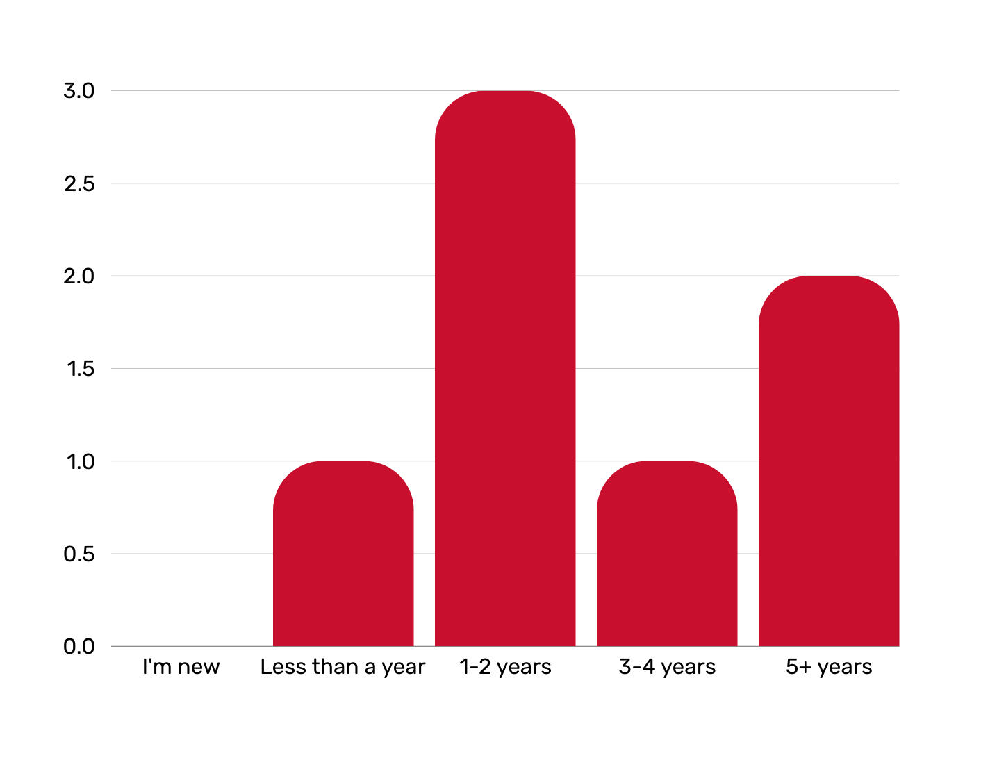
How long have you been doing assessments for your department/division? How long have you worked with assessment in various capacities?

Slide 3
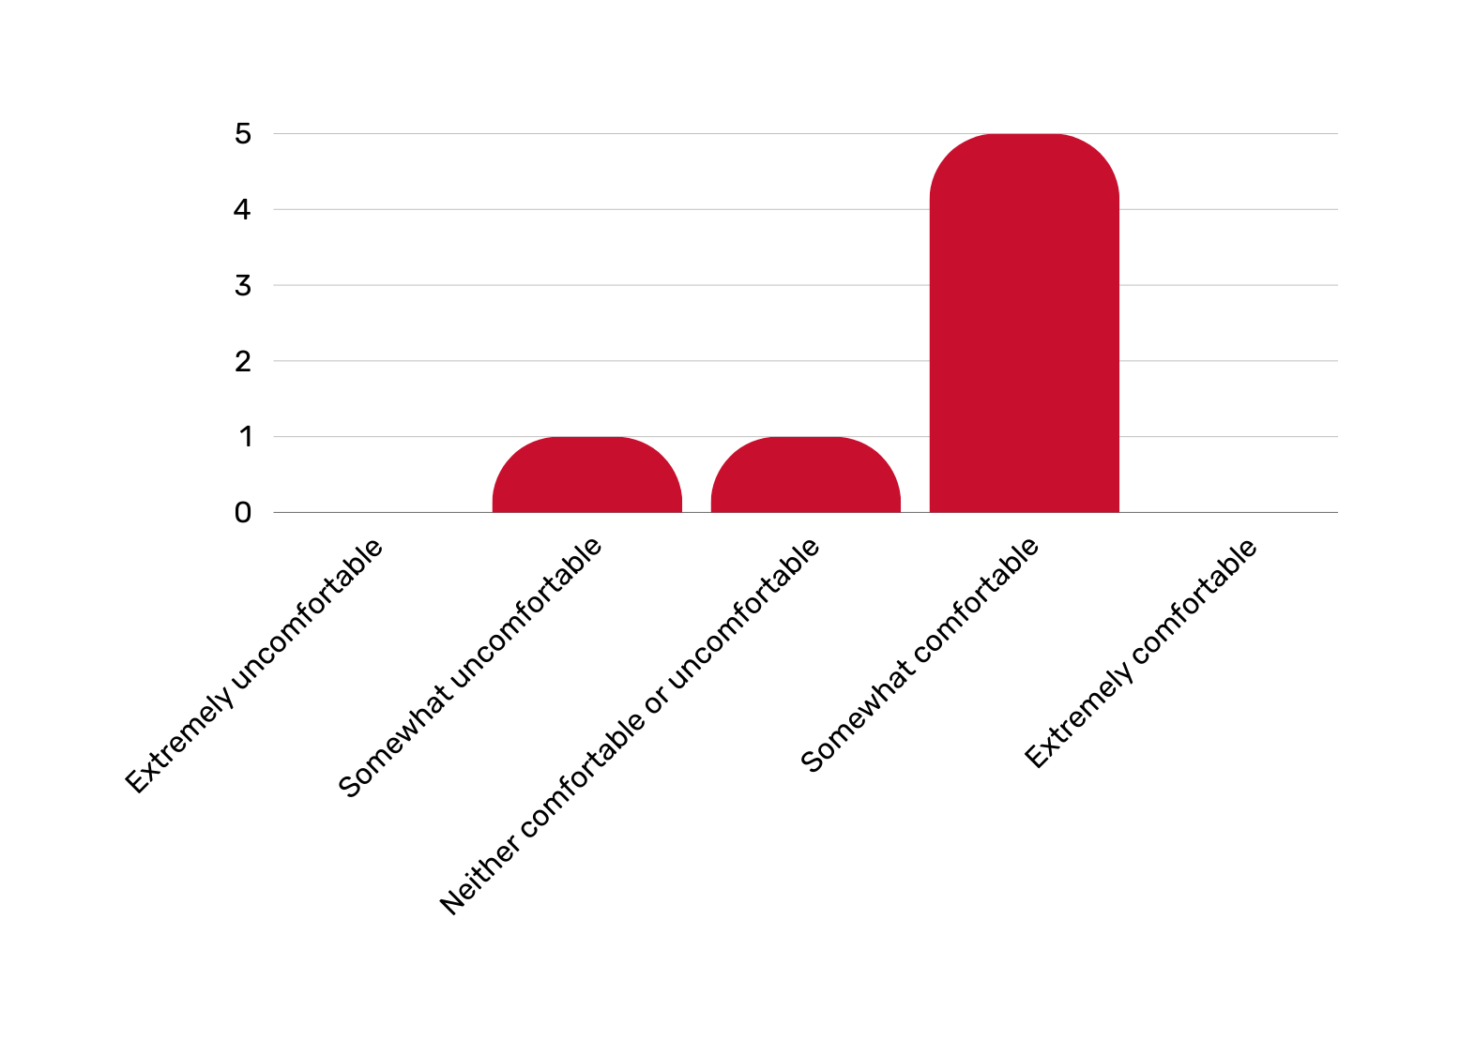
How comfortable are with assessments?

Slide 4
Let’s see what you think.
How comfortable are with assessments?

Slide 5
What is a formal assessment?
“Assessment is the process of collecting and analyzing information to determine if progress is being made toward a desired end” (AALHE, 2020).

Slide 6
What is a formal assessment?
“Assessment is the process of collecting and analyzing information to determine if progress is being made toward a desired end” (AALHE, 2020).

Slide 7
What is assessment?
“Assessment is the process of collecting and analyzing information to determine if progress is being made toward a desired end” (AALHE, 2020).
Formative
The goal is to monitor growth, student engagement, and mission alignment, in the moment. These are low stakes and help departments see where they are at.
Survey to follow up an event or program.
Campus survey to measure how change is received.

Slide 8
What is assessment?
“Assessment is the process of collecting and analyzing information to determine if progress is being made toward a desired end” (AALHE, 2020).
Formative
The goal is to monitor growth, student engagement, and mission alignment, in the moment. These are low stakes and help departments see where they are at.
Survey to follow up an event or program.
Campus survey to measure how change is received.
Summative
The goal is to evaluate growth, student engagement, and mission alignment after a period of time. This is how you determine whether or not you’ve met your goal or progressed toward a desired end.
Yearly stats that show a growth/decline in participation.
The completion of a goal with data to support the initiative.
Annual report with highlights of accomplishments or changes.

Slide 9
Benefits of Formal Assessment
Assessments allow us to demonstrate the effectiveness of our institution, departments, units, programs, and courses.

Slide 10
Benefits of Formal Assessment
Assessments allow us to demonstrate the effectiveness of our institution, departments, units, programs, and courses.
This is how we measure SRSU’s impact on students and alumni.

Slide 11
Benefits of Formal Assessment
Assessments allow us to demonstrate the effectiveness of our institution, departments, units, programs, and courses.
This is how we measure SRSU’s impact on students and alumni.
This is how we measure the impact of an academic, administrative, or student support department.

Slide 12
Benefits of Formal Assessment
Assessments allow us to demonstrate the effectiveness of our institution, departments, units, programs, and courses.
This is how we measure SRSU’s impact on students and alumni.
This is how we measure the impact of an academic, administrative, or student support department.
This is how we measure entire units and their effectiveness in achieving the university mission.

Slide 13
Benefits of Formal Assessment
Assessments allow us to demonstrate the effectiveness of our institution, departments, units, programs, and courses.
This is how we measure SRSU’s impact on students and alumni.
This is how we measure the impact of an academic, administrative, or student support department.
This is how we measure entire units and their effectiveness in achieving the university mission.
This is how we measure programs and their impact on current and incoming students.

Slide 14
Benefits of Formal Assessment
Assessments allow us to demonstrate the effectiveness of our institution, departments, units, programs, and courses.
This is how we measure SRSU’s impact on students and alumni.
This is how we measure the impact of an academic, administrative, or student support department.
This is how we measure entire units and their effectiveness in achieving the university mission.
This is how we measure programs and their impact on current and incoming students.
This is how we measure courses to see the growth of our students from their freshman to senior year and on into graduate studies.
Notes:
You can see how assessments are embedded in every part of the institution and are a helpful tool to help us determine what we do well and what we need to improve. All institutions assess themselves, and Sul Ross is no different.

Slide 15
Assessment as a Tool
Assessments can happen in various ways, using multiple tools and measures that differ from report to report. The beauty of assessment is that it is yours. The institution, departments, units, programs, and courses get to determine the following:
What do I want to know about X?
What do we know in theory but do not have evidence for?
Does the senior capstone accurately demonstrate student knowledge?
Does the field report in X course help prepare students for their upper-level coursework?

Slide 16
Assessment as a Tool
The beauty of assessment is that it is yours.
What do you want to demonstrate?
Can we increase student engagement by doing X?
Can we raise student job placement rates after graduation if we do X?
Can we grow our graduate program with current students if we do X?
Faculty and staff are satisfied with X service.
X service moves faster than ever before, and we can prove it!

Slide 17
Assessment as a Tool
The beauty of assessment is that it is yours.
UT-Arlington Examples of Administrative Outcomes
What types of things is your unit striving for?
In what direction do you want your unit to move?
What would you like to accomplish during the upcoming academic year and why?
In terms of intended outcomes, what would the “perfect” unit look like?
Will data be obtained that can be used to improve programs and services?

Slide 18
Let’s see what you think.
What is a question, theory, or unsupported claim you have about the institution, a department, or a unit/division?

Slide 19
What is SACSCOC?
Pronounced SACKS
The Southern Association of Colleges and Schools Commission on Colleges
The accrediting agency for SRSU
Sets standards that institutions must follow and report on every 5 and 10 years

Slide 20
SACSCOC
Assessment Timeline
2028
Reaffirmation Review
Data Collection Period
2023
Fifth Year Interim Report
The Fifth Year Interim Report covered data from AY17-18 to 22-23 and was submitted on March 1, 2024.
The Reaffirmation Review will be an on-site visit in spring 2028, however, the report must be submitted August 2027.
The Reaffirmation Review must include a minimum of three years data (AY24-25 to 26-27).

Slide 21
STANDARD 7.3
STANDARD 8.2.c
Administrative effectiveness
Student outcomes: academic & student services
Concerns “administrative support services”
Units that “support student success”
Units that help the university reach their strategic goals
Units whose quality of service impacts student success
Units that help the university operate efficiently
Units that provide direct support to faculty and students as related to their educational programs
Serve the educational mission of the institution in an indirect way

Slide 22
STANDARD 12.1 STUDENT SUPPORT SERVICES
The institution provides appropriate academic and student support programs, services, and activities consistent with its mission.
Service | Prospective | Freshman | Undergrad | Graduate | Off-Campus Sites | Faculty | Staff
Counseling and Accessibility Services |  | X | X | X | X | X | X
Testing Center | X | X | X | X | X | X
McNair Scholars Program |  |  | X |  |  | X
Bryan Wildenthal Memorial Library |  | X | X | X | X | X | X

Slide 23
SRSU
Assessment Model

Slide 24
Institutional Assessment Pyramid
Core Curriculum
Administrative Assessments
Student Support Assessments
Academic Assessments
Academic Program Review
Strategic Plan Alignment
SACSCOC Accreditation Review

Slide 25
Shifting to a New Model of Assessment Reporting
64 departments
Included each academic program
Included non-student support and administrative grants (i.e. SBDC);
Difficult to maintain;
Departments had duplicated outcomes meant for the benefit of one department.
Administrative Assessment Coordinators
Est. 2018-2023

Slide 26
Shifting to a New Model of Assessment Reporting
64 departments
Included each academic program
Included non-student support and administrative grants (i.e. SBDC);
Difficult to maintain;
Departments had duplicated outcomes meant for the benefit of one department.
Administrative Assessment Coordinators
Est. 2018-2023
Administrative Assessment Coordinators
Student Support
Assessment
Coordinators
Starts Assessment Year 24-25
Starts Assessment Year 24-25
18 departments
Aligned to departments who are either serving the university’s mission, directly, or who have outcomes listed in the current Strategic Plan.
18 departments
Aligned to departments who support student learning, persistence, and overall satisfaction outside of the classroom.

Slide 27
What about the Strategic Plan?
STANDARD 7.1 INSTITUTIONAL PLANNING & EFFECTIVENESS
The institution engages in ongoing, comprehensive, and integrated research-based planning and evaluation processes that (a) focus on institutional quality and effectiveness and (b) incorporate a systematic review of institutional goals and outcomes consistent with its mission.

Slide 28
What about the Strategic Plan?
STANDARD 7.1 INSTITUTIONAL PLANNING & EFFECTIVENESS
The institution engages in ongoing, comprehensive, and integrated research-based planning and evaluation processes that (a) focus on institutional quality and effectiveness and (b) incorporate a systematic review of institutional goals and outcomes consistent with its mission.
We know we have to maintain and assess a strategic plan for the institution and that we have to have assessment reports.
Why can’t the two be combined?

Slide 29
Aligning the Strategic Plan by Departments

Slide 30
Assessments + Strategic Alignment = One Report!

Slide 31
Let’s see what you think.
What is a question, theory, or unsupported claim you have about the institution, a department, or a unit/division?

Slide 32
Group/Partner Activity
With your group/partner, consider ways that you might collect and analyze information to determine if progress is being made to answer the group’s questions.

Slide 35
Save the Date!
Tuesday, May 14, 2024
3:00 to 4:30 pm
Location: TBD

Slide 36
References
AALHE. (2020). Foundational statement #1: What is assessment in higher education?. https://www.aalhe.org/foundational-statement-1

