Slide 1



Quality & Efficiency in Student Success
Assessment Excellence @ SRSU Workshop Series #2

Slide 2

Agenda
  Introductions & Your Role
  Review of Assessment Workshop #1
  Identifying Unit Capacity for Assessment
  Inquiry-based Praxis Model
    Queries
    Outcomes
  Assessment Reporting Structure
  Group Activity
  Individual Activity
  Wrapping it up

Slide 3
Introductions & Your Role
Institutional Effectiveness / Assessment Team
  Kayla Waggoner
  Isabella Lujan
  April Aultman Becker

Slide 4
Introductions & Your Role
Institutional Effectiveness / Assessment Team
  Kayla Waggoner
  Isabella Lujan
  April Aultman Becker
Administrative Assessment Coordinators
  Responsible for unit assessment plans
  Responsible for submitting results on assessment plans

Slide 5
Introductions & Your Role
Institutional Effectiveness / Assessment Team
  Kayla Waggoner
  Isabella Lujan
  April Aultman Becker
Administrative Assessment Coordinators
  Responsible for unit assessment plans
  Responsible for submitting results on assessment plans
Excellence in assessment is a team effort.

Slide 6

Let’s measure our growth.
How comfortable are with assessments?

Slide 7
Your turn!
Define “assessment” in your own words.

Slide 8
What is a formal assessment?
“Assessment is the process of collecting and analyzing information to determine if progress is being made toward a desired end” (AALHE, 2020).
Review of Assessment Workshop #1

Slide 9
What is a formal assessment?
“Assessment is the process of collecting and analyzing information to determine if progress is being made toward a desired end” (AALHE, 2020).
Review of Assessment Workshop #1

Slide 10
STANDARD 7.3
STANDARD 8.2.c
Administrative effectiveness
Student outcomes: academic & student services
  Concerns “administrative support services”
  Units that “support student success”
  Units that help the university reach their strategic goals
  Units whose quality of service impacts student success
  Units that help the university operate efficiently
  Units that provide direct support to faculty and students as related to their educational programs
  Serve the educational mission of the institution in an indirect way
Review of Assessment Workshop #1

Slide 11
STANDARD 12.1 STUDENT SUPPORT SERVICES
The institution provides appropriate academic and student support programs, services, and activities consistent with its mission.
Service | Prospective | Freshman | Undergrad | Graduate | Off-Campus Sites | Faculty | Staff
Counseling and Accessibility Services |  | X | X | X | X | X | X
Testing Center | X | X | X | X | X | X
McNair Scholars Program |  |  | X |  |  | X
Bryan Wildenthal Memorial Library |  | X | X | X | X | X | X
Review of Assessment Workshop #1

Slide 12
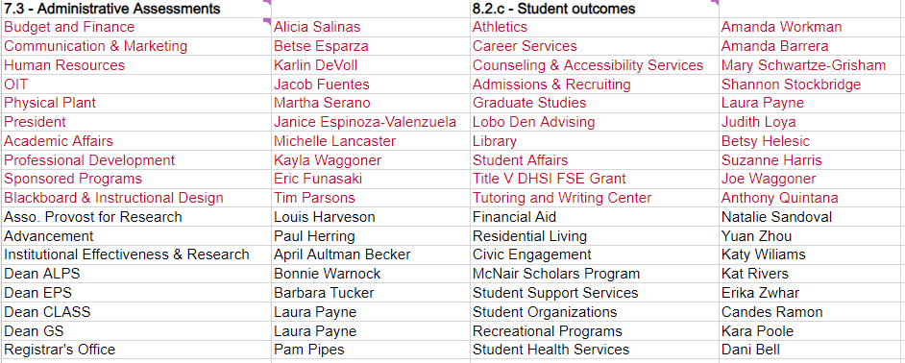
Assessments + Strategic Alignment = One Report!
Review of Assessment Workshop #1

Slide 13
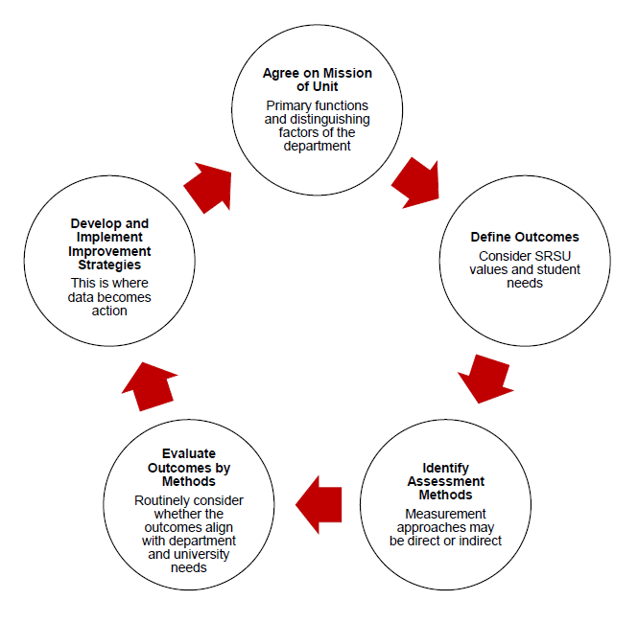
Cycle of Continual Improvement
Review of Assessment Workshop #1

Slide 14

Cycle of Continual Improvement?
Review of Assessment Workshop #1

Slide 15
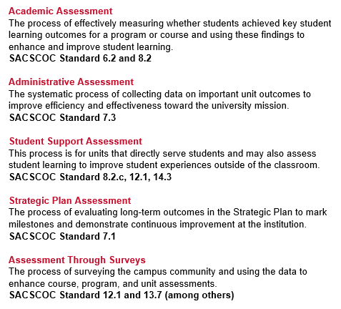
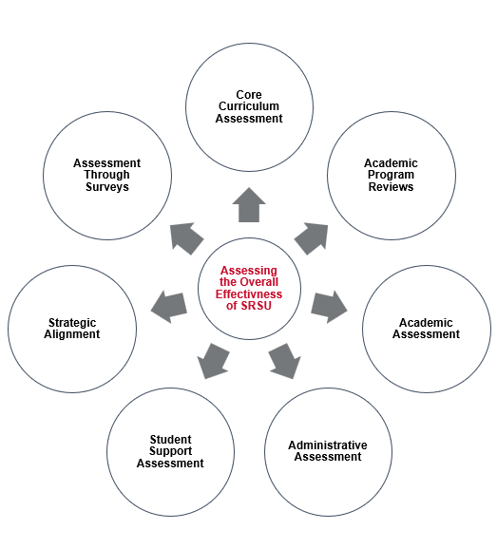
SRSU
Assessment Model
Review of Assessment Workshop #1

Slide 16
What would you like to improve on in your department?

Slide 17
Unit Assessment Plans
For administrative assessments we have:
  Departments (i.e. Accounting, Institutional Effectiveness, Dean of X College)
  Divisions (i.e. Student Affairs, Athletics, Academic Affairs)
  Programs (i.e. Lobo LEADS, Pack First Program)
To simplify all of this we will refer to the departments, divisions, or programs being reported on as UNITS.
Review of Assessment Workshop #1

Slide 18
Capacity
  Dedicated time to assessments in your unit.
Identifying Unit Capacity for Assessment

Slide 19
Capacity
  Dedicated time to assessments in your unit.
  Unit commitment and buy-in for determined outcomes.
Identifying Unit Capacity for Assessment

Slide 20
Capacity
  Dedicated time to assessments in your unit.
  Unit commitment and buy-in for determined outcomes.
  Psychological Safety of the unit, both internally and externally.
Identifying Unit Capacity for Assessment

Slide 21
Regarding department capacity, rank these issues to determine your immediate needs.

Slide 22
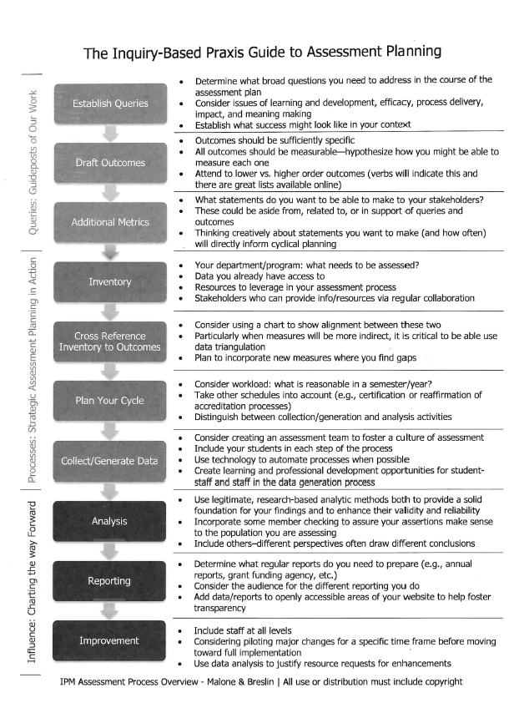
Inquiry-based Praxis Model

Slide 23
The Inquiry-based Praxis Guide to Assessment Planning
PART ONE
Queries: Guideposts of Our Work
  Determine what broad questions you need to address in the course of the assessment plan
  Consider issues of learning and development, efficacy, process delivery, impact, and meaning making
  Establish what success might look like in your context
Establish Queries
Inquiry-based Praxis Model

Slide 24
The Inquiry-based Praxis Guide to Assessment Planning
PART ONE
Queries: Guideposts of Our Work
  Determine what broad questions you need to address in the course of the assessment plan
  Consider issues of learning and development, efficacy, process delivery, impact, and meaning making
  Establish what success might look like in your context
Establish Queries
Draft Outcomes
  Outcomes should be sufficiently specific
  All outcomes should be measurable; hypothesize how you might be able to measure each one
Inquiry-based Praxis Model

Slide 25
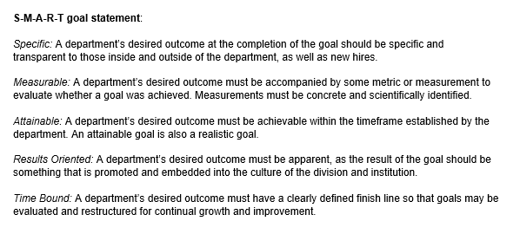
Unit Outcomes are basically SMART goals

Slide 26
Unit Outcomes are basically SMART goals
OUTCOME
METHOD
TARGET
ANNUAL HIGHLIGHT
SMART Goal
Work on it over time
Achieve your goal
Write your end-of-goal summary

Slide 27
Quantitative or Qualitative Research Design
OUTCOME
  Write your hypothesis
    What research question are you trying to solve?

Slide 28
Quantitative or Qualitative Research Design
OUTCOME
  Write your hypothesis
METHOD
  Write your methodology

Slide 29
Quantitative or Qualitative Research Design
OUTCOME
  Write your hypothesis
METHOD
  Write your methodology
    How will you test your hypothesis to see if you’re correct?
    What will you use as a measurement of success?
    What are your indicators?

Slide 30
Quantitative or Qualitative Research Design
OUTCOME
  Write your hypothesis
METHOD
  Write your methodology
TARGET
  Test your experiment and gather results

Slide 31
Quantitative or Qualitative Research Design
OUTCOME
  Write your hypothesis
METHOD
  Write your methodology
TARGET
  Test your experiment and gather results
ANNUAL HIGHLIGHT
  Write your conclusion

Slide 32

Hot Tip
Don’t make your assessment plan so specific that no one else can jump in and continue the work.

Slide 33
The Inquiry-based Praxis Guide to Assessment Planning
PART ONE
Queries: Guideposts of Our Work
  Determine what broad questions you need to address in the course of the assessment plan
  Consider issues of learning and development, efficacy, process delivery, impact, and meaning making
  Establish what success might look like in your context
Establish Queries
Draft Outcomes
  Outcomes should be sufficiently specific
  All outcomes should be measurable-hypothesize how you might be able to measure each one
  What statements do you want to be able to make to your stakeholders?
  These could be aside from, related to, or in support of queries and outcomes
  Thinking creatively about statements you want to make (and how often) will directly inform cyclical planning.
Additional Metrics
Inquiry-based Praxis Model

Slide 34
The Inquiry-based Praxis Guide to Assessment Planning
PART TWO
Processes: Strategic Assessment Planning in Action
  Your unit: what needs to be assessed?
  Data you already have access to
  Resources to leverage in your assessment process
  Stakeholders who can provide info/resources via regular collaboration
Inventory
Inquiry-based Praxis Model

Slide 35
The Inquiry-based Praxis Guide to Assessment Planning
PART TWO
Processes: Strategic Assessment Planning in Action
  Your unit: what needs to be assessed?
  Data you already have access to
  Resources to leverage in your assessment process
  Stakeholders who can provide info/resources via regular collaboration
Inventory
Cross Reference Inventory to Outcomes
  Consider using a chart to show alignment between these two
  Particularly when measures will be more indirect, it is critical to be able to use data triangulation
  Plan to incorporate new measures where you find gaps
Inquiry-based Praxis Model

Slide 36
The Inquiry-based Praxis Guide to Assessment Planning
PART TWO
Processes: Strategic Assessment Planning in Action
  Your unit: what needs to be assessed?
  Data you already have access to
  Resources to leverage in your assessment process
  Stakeholders who can provide info/resources via regular collaboration
Inventory
Cross Reference Inventory to Outcomes
  Consider using a chart to show alignment between these two
  Particularly when measures will be more indirect, it is critical to be able to use data triangulation
  Plan to incorporate new measures where you find gaps
We’ll go through the last two components of Part Two and all of Part Three in the next workshop.
Inquiry-based Praxis Model

Slide 37

ACTIVITY:
Work on filling out the Queries and Outcomes worksheet

Slide 38
SRSU
Mission
Vision Statement
Values
We aspire to be the best value in Texas higher education and expand access to higher education for the underserved populations in the State. We will accomplish this by providing high quality, innovative, and flexible academic programs within a culturally inclusive environment, where students learn to develop creativity, foster critical thinking, enhance diversity, and engage in research to serve our region, state, and nation as impactful members of an educated society.
Sul Ross State University offers life-changing opportunities by delivering quality undergraduate and graduate education. We foster critical thinking, creativity, diversity, and research, empowering our students to excel beyond the frontiers of what is possible. We are a Hispanic serving public institution for the residents of the U.S./Mexico borderlands, Southwest Texas region, and beyond.
  Student Access and Success
  Ethics and Integrity
  Academic Excellence
  Diversity, Equity, and Inclusion
  Mutual Respect and Collaboration
Inquiry-based Praxis Model

Slide 39
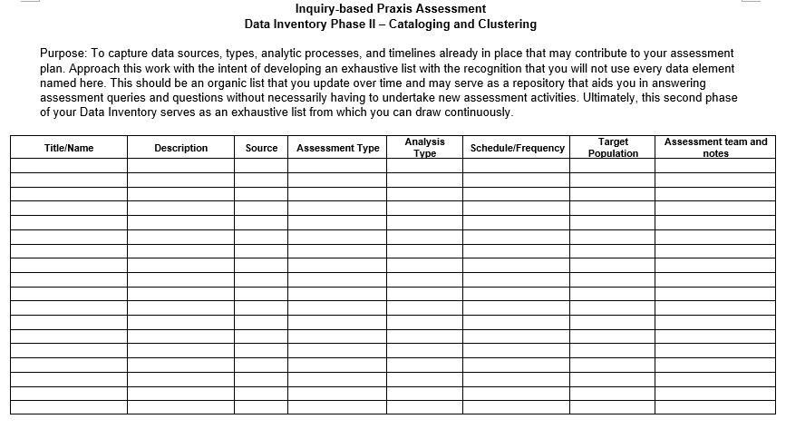
Data Inventory
Inquiry-based Praxis Model

Slide 40
Fist-to-Five
How we doing?

Slide 41
Assessment Plan Examples

Slide 42
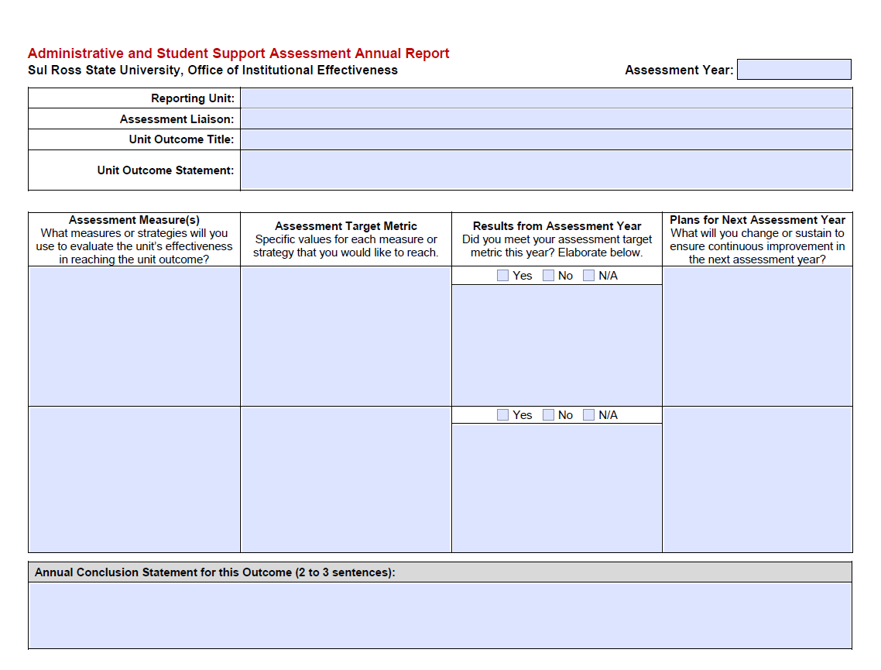

Slide 43
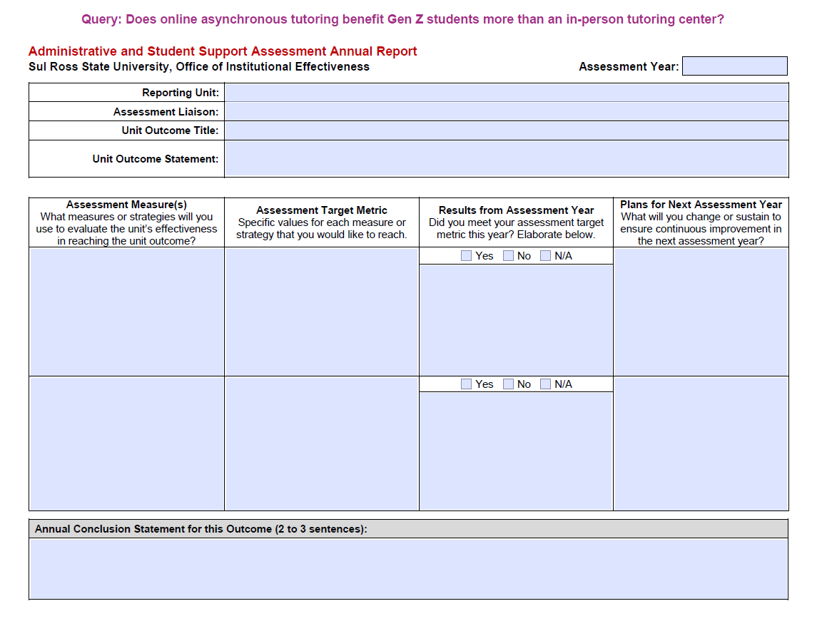

Slide 44
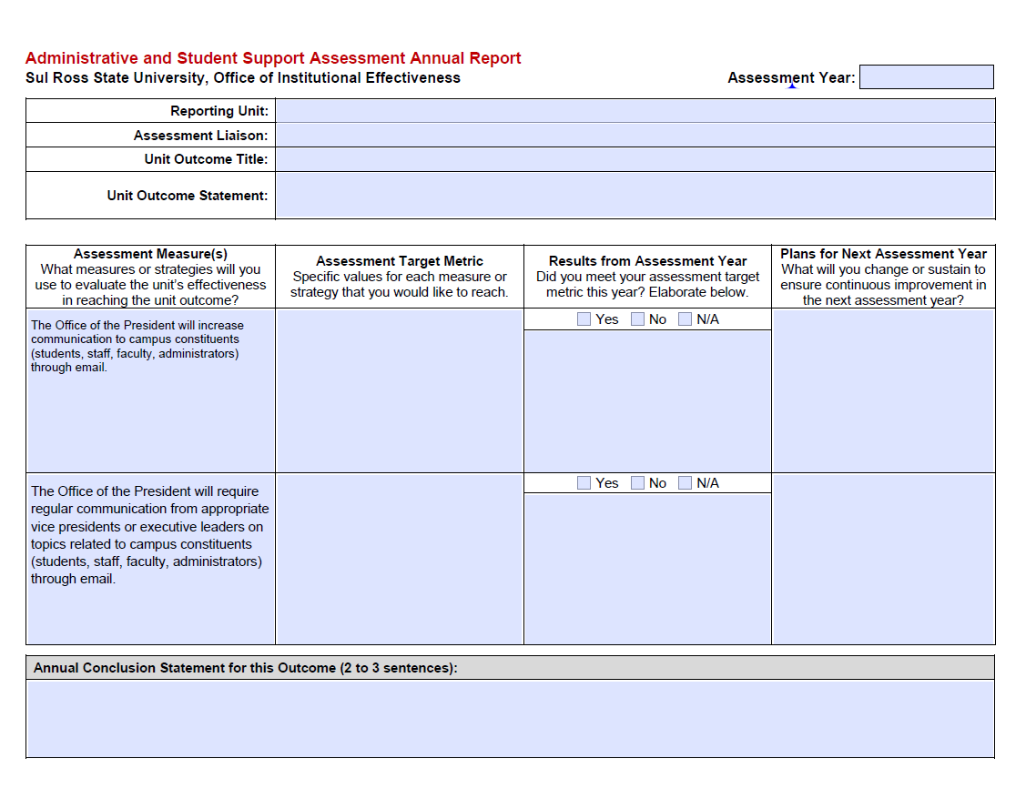

Slide 45
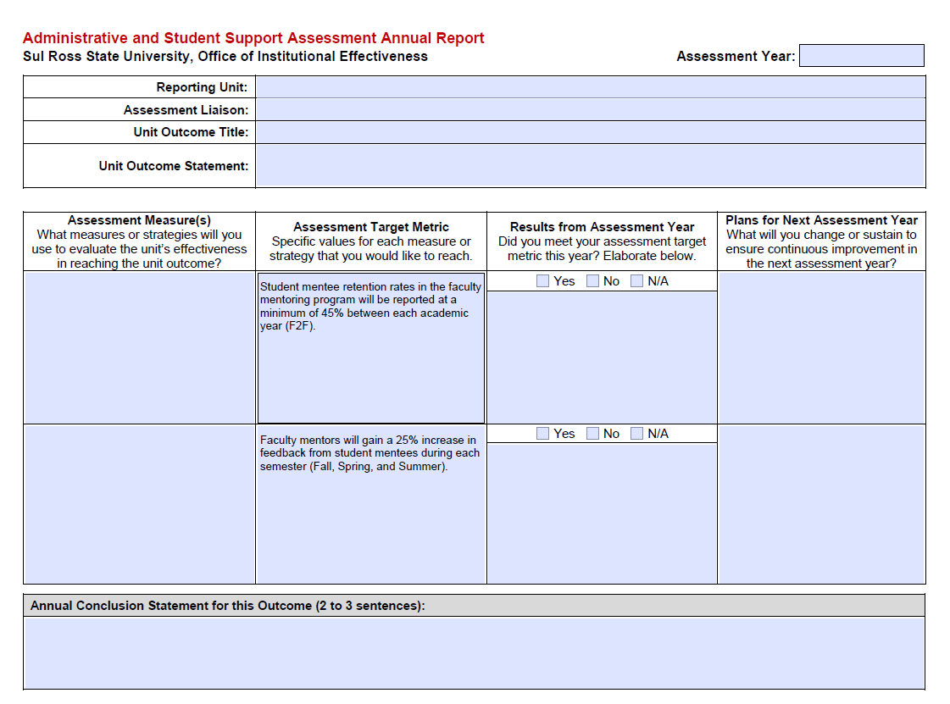

Slide 46
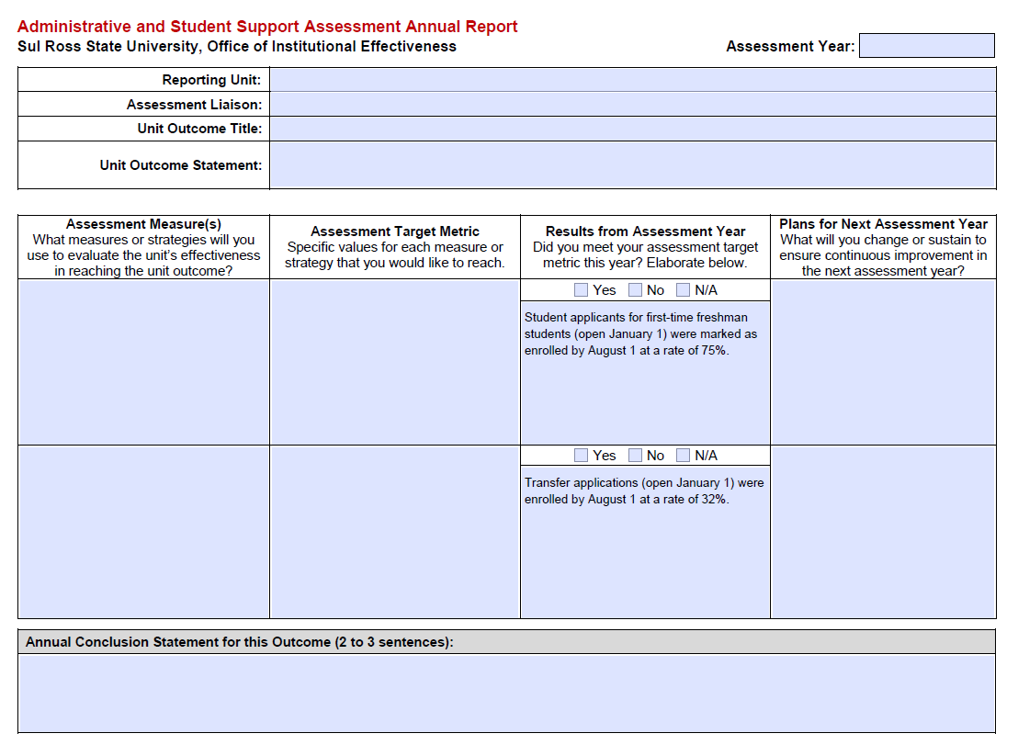

Slide 47
Group/Partner Activity
With your group/partner, try to complete the forms given to create an assessment plan based on information that you are aware of.

Slide 49
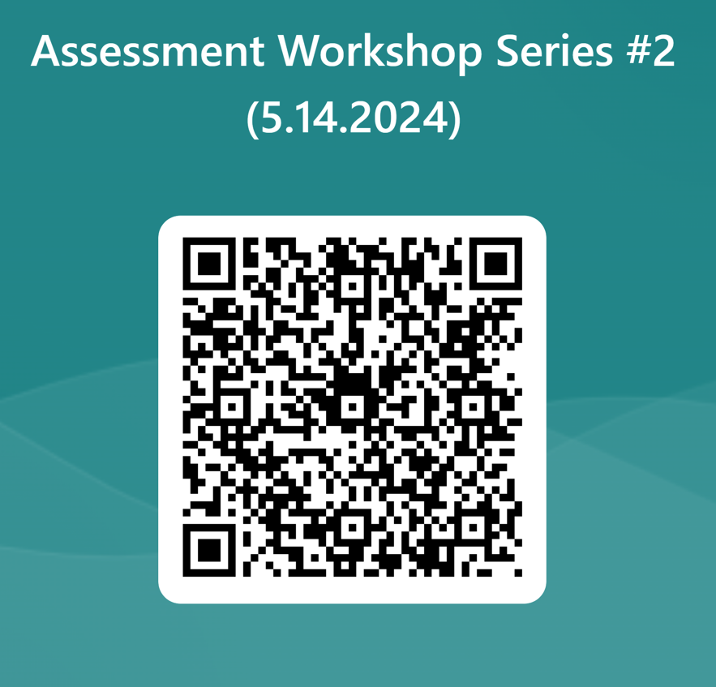


Slide 50
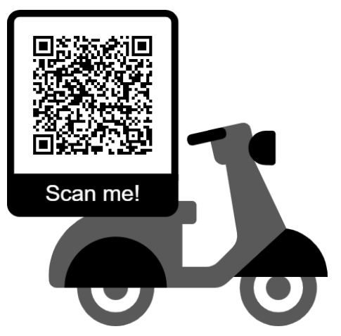
Register for Assessment One-on-Ones
In these meetings we will:
  Finalize outcome statements,
  Determine appropriate measures, targets, and anticipated results,
  Have an idea of where your unit is heading toward inn this next assessment cycle.

Slide 51
Save the Date!
Tuesday, June 25, 2024
2:00 to 3:30 pm
Virtual Session

Slide 52
References
AALHE. (2020). Foundational statement #1: What is assessment in higher education?. https://www.aalhe.org/foundational-statement-1

