Slide 1



Quality & Efficiency in Student Success
Assessment Excellence @ SRSU Workshop Series #3

Slide 2

Agenda
  Review Workshop 1 & 2
  Inquiry-Based Praxis Guide, Part 3
  Cross-Campus Collaboration
  Annual Reporting requirements
  Term Placements
  SACSCOC expectations
  One-on-one’s for Assessment Plans
  Q&A

Slide 3

Let’s measure our growth.
How comfortable are with assessments?

Slide 4
Your turn!
Define “assessment” in your own words.

Slide 5
What is a formal assessment?
“Assessment is the process of collecting and analyzing information to determine if progress is being made toward a desired end” (AALHE, 2020).

Slide 6
What is a formal assessment?
“Assessment is the process of collecting and analyzing information to determine if progress is being made toward a desired end” (AALHE, 2020).

Slide 7
STANDARD 7.3
STANDARD 8.2.c
Administrative effectiveness
Student outcomes: academic & student services
  Concerns “administrative support services”
  Units that “support student success”
  Units that help the university reach their strategic goals
  Units whose quality of service impacts student success
  Units that help the university operate efficiently
  Units that provide direct support to faculty and students as related to their educational programs
  Serve the educational mission of the institution in an indirect way

Slide 8
STANDARD 12.1 STUDENT SUPPORT SERVICES
The institution provides appropriate academic and student support programs, services, and activities consistent with its mission.
Service | Prospective | Freshman | Undergrad | Graduate | Off-Campus Sites | Faculty | Staff
Counseling and Accessibility Services |  | X | X | X | X | X | X
Testing Center | X | X | X | X | X | X
McNair Scholars Program |  |  | X |  |  | X
Bryan Wildenthal Memorial Library |  | X | X | X | X | X | X

Slide 9
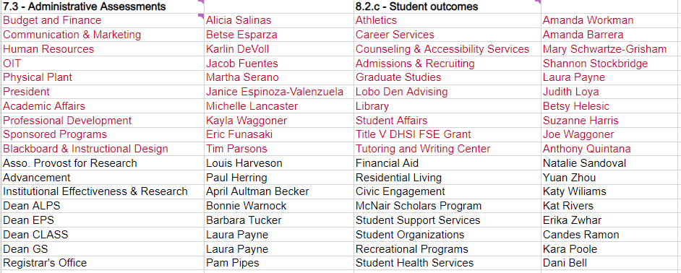
Assessments + Strategic Alignment = One Report!

Slide 10
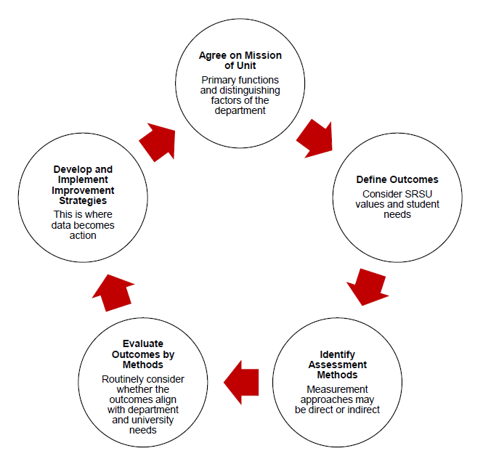
Cycle of Continual Improvement

Slide 11
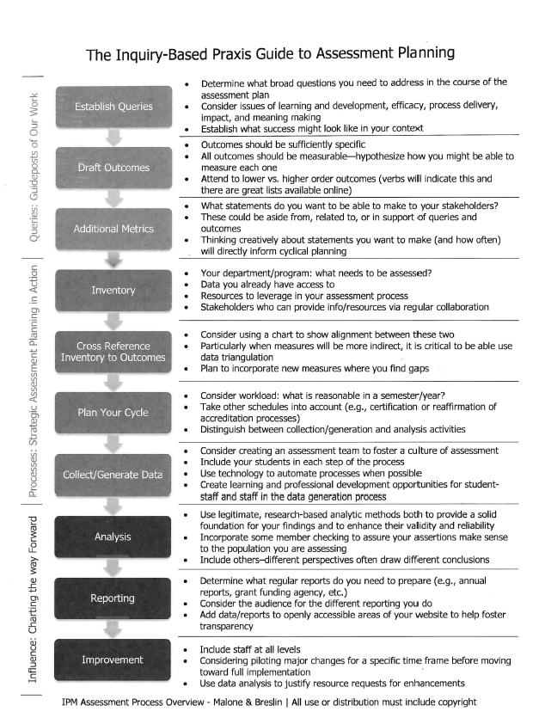

Slide 12
The Inquiry-based Praxis Guide to Assessment Planning
PART ONE
Queries: Guideposts of Our Work
  Determine what broad questions you need to address in the course of the assessment plan
  Consider issues of learning and development, efficacy, process delivery, impact, and meaning making
  Establish what success might look like in your context
Establish Queries
Draft Outcomes
  Outcomes should be sufficiently specific
  All outcomes should be measurable-hypothesize how you might be able to measure each one
  What statements do you want to be able to make to your stakeholders?
  These could be aside from, related to, or in support of queries and outcomes
  Thinking creatively about statements you want to make (and how often) will directly inform cyclical planning.
Additional Metrics

Slide 13
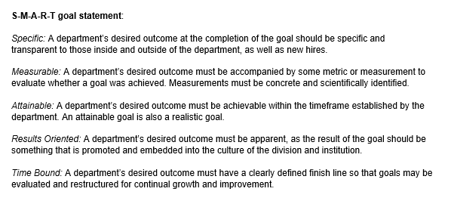
Unit Outcomes are basically SMART goals

Slide 14
Quantitative or Qualitative Research Design
OUTCOME
  Write your hypothesis
METHOD
  Write your methodology
TARGET
  Test your experiment and gather results
ANNUAL HIGHLIGHT
  Write your conclusion

Slide 15
The Inquiry-based Praxis Guide to Assessment Planning
PART TWO
Processes: Strategic Assessment Planning in Action
  Your unit: what needs to be assessed?
  Data you already have access to
  Resources to leverage in your assessment process
  Stakeholders who can provide info/resources via regular collaboration
Inventory
Cross Reference Inventory to Outcomes
  Consider using a chart to show alignment between these two
  Particularly when measures will be more indirect, it is critical to be able to use data triangulation
  Plan to incorporate new measures where you find gaps

Slide 16
The Inquiry-based Praxis Guide to Assessment Planning
PART TWO
Processes: Strategic Assessment Planning in Action
  Consider workload: what is reasonable in a semester/year?
  Take other schedules into account (e.g., certification or reaffirmation of accreditation processes)
  Distinguish between collection/generation and analysis activities
Plan Your Cycle
  Consider creating an assessment team to foster a culture of assessment
  Include your students in each step of the process
  Use technology to automate processes when possible
  Create learning and professional development opportunities for student-staff and staff in the data generation process
Collect/
Generate Data

Slide 17
The Inquiry-based Praxis Guide to Assessment Planning
PART THREE
Influence: Charting the way Forward
  Use legitimate, research-based analytic methods both to provide a solid foundation for your findings and to enhance their validity and reliability
  Incorporate some member checking to assure your assertions make sense to the population you are assessing
  Include others - different perspectives often draw different conclusions
Analysis

Slide 18
The Inquiry-based Praxis Guide to Assessment Planning
PART THREE
Influence: Charting the way Forward
  Use legitimate, research-based analytic methods both to provide a solid foundation for your findings and to enhance their validity and reliability
  Incorporate some member checking to assure your assertions make sense to the population you are assessing
  Include others - different perspectives often draw different conclusions
Analysis
  Determine what regular reports do you need to prepare (e.g., annual reports, grant funding agency, etc.)
  Consider the audience for the different reporting you do
  Add data/reports to openly accessible areas of your website to help foster transparency
Reporting

Slide 19
The Inquiry-based Praxis Guide to Assessment Planning
PART THREE
Influence: Charting the way Forward
  Use legitimate, research-based analytic methods both to provide a solid foundation for your findings and to enhance their validity and reliability
  Incorporate some member checking to assure your assertions make sense to the population you are assessing
  Include others - different perspectives often draw different conclusions
Analysis
  Determine what regular reports do you need to prepare (e.g., annual reports, grant funding agency, etc.)
  Consider the audience for the different reporting you do
  Add data/reports to openly accessible areas of your website to help foster transparency
Reporting
  Include staff at all levels
  Considering piloting major changes for a specific time frame before moving toward full implementation
  Use data analysis to justify resource requests for enhancements
Improvement

Slide 20
Cross-Campus Collaboration
Can you work with other units or reports to curate your assessment plan?
  Campus Environment Survey
  National Survey of Student Engagement
  Trellis Financial Wellness Survey
  RNL Student Satisfaction Inventory
  Disaggregated data?
  Other examples?

Slide 21
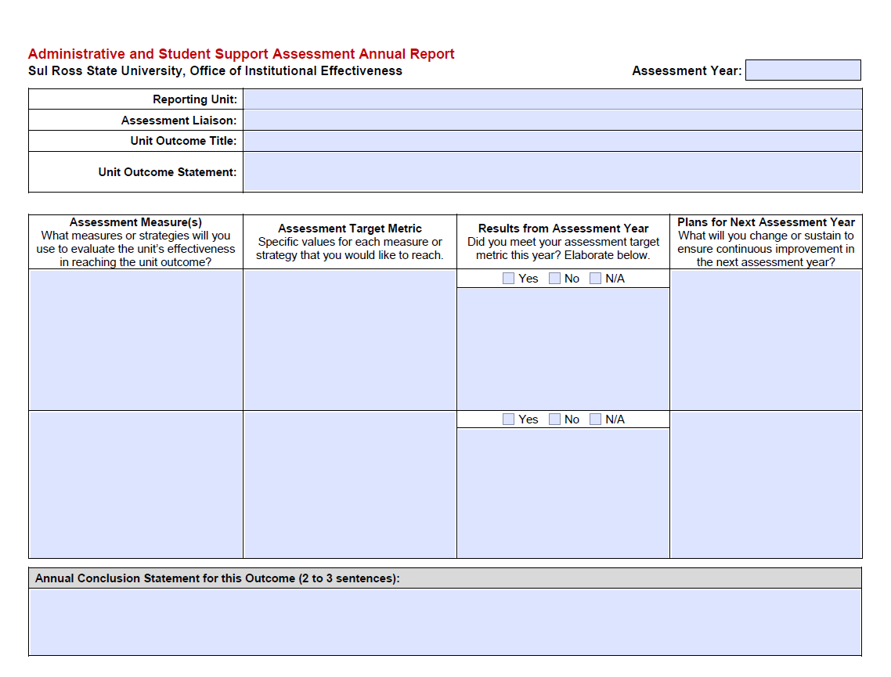
Reporting Requirements

Slide 22
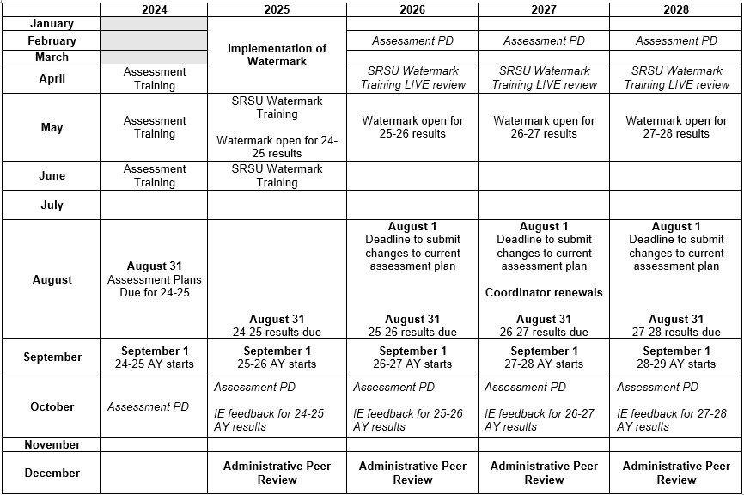
Reporting Requirements

Slide 23

Reporting Requirements
3 Year Term
Placements

Slide 24
SACSCOC Expectations
They read everything...

Slide 25
Assessment Plan Examples

Slide 27
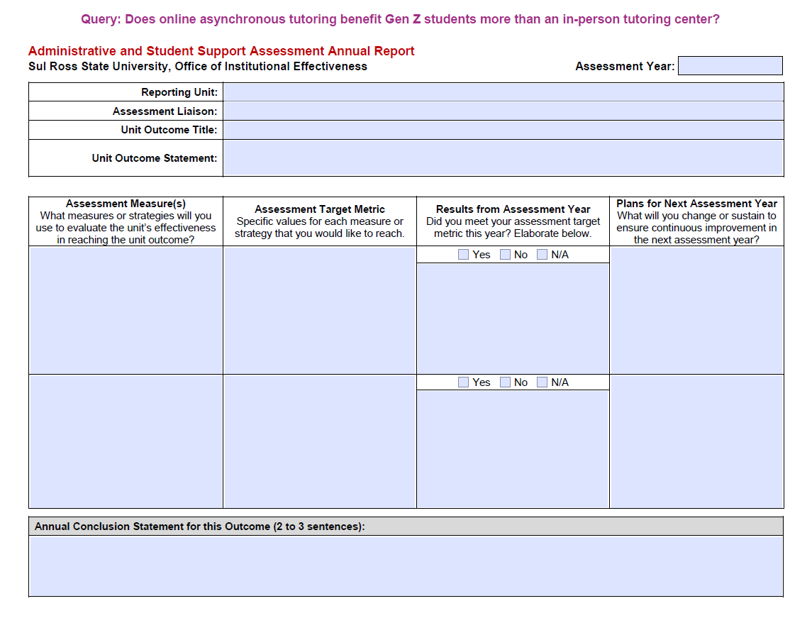

Slide 28
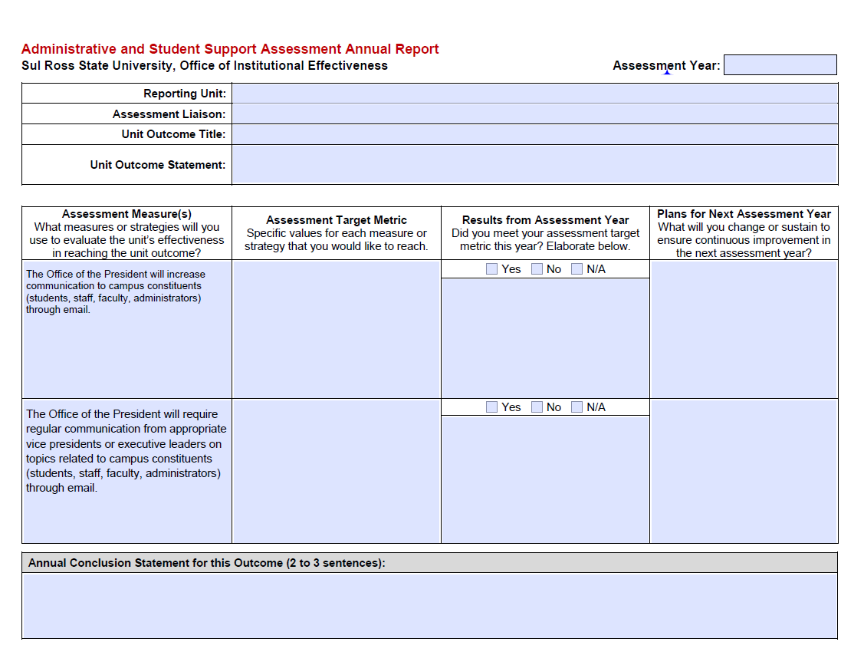

Slide 29
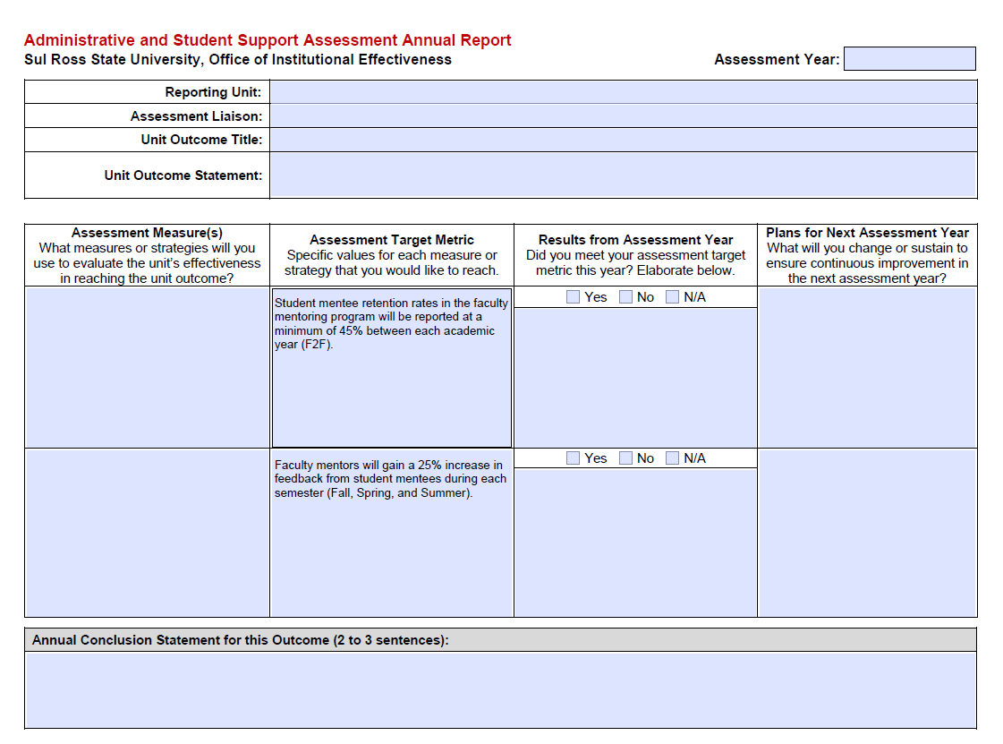

Slide 30
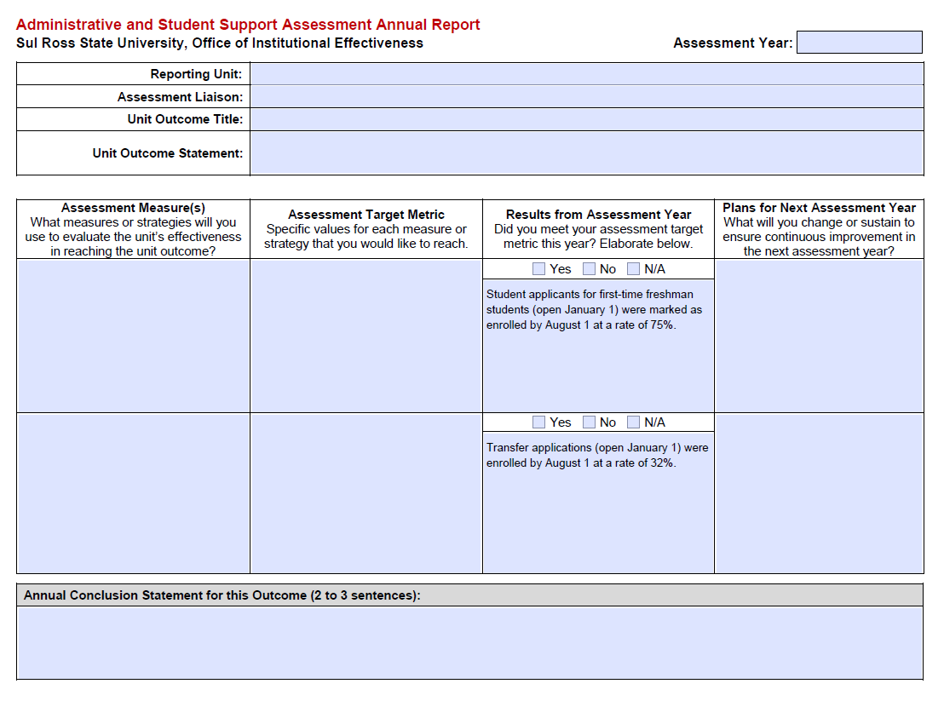

Slide 31
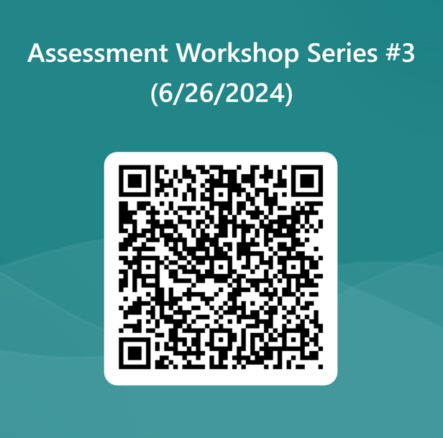


Slide 32

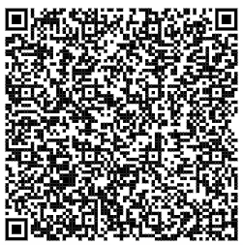
Register for Assessment One-on-Ones
In these meetings we will:
  Finalize outcome statements,
  Determine appropriate measures, targets, and anticipated results,
  Have an idea of where your unit is heading toward in this next assessment cycle.
Notes:
https://outlook.office.com/bookwithme/user/2b582531f6bc47c5a23637c761b5dd2f@sulross.edu/meetingtype/ExEWZ9lSQkmbgwYEXQIG4A2?bookingcode=86e7701d-f246-4a8d-8279-8a7c4a3aa703&anonymous

Slide 33
References
AALHE. (2020). Foundational statement #1: What is assessment in higher education?. https://www.aalhe.org/foundational-statement-1

