Slide 1

WATERMARK
COURSE EVALUATIONS
How to access the faculty course evaluation reports.

Slide 2
WATERMARK COURSE EVALUATIONS & SURVEYS (CES)
  With the migration to Blackboard Ultra in 2024, SRSU was forced to consider another solution for administering course evaluations at the end of each term.
  Academic Affairs and the Office of Institutional Effectiveness worked with various faculty committees and representatives to gain feedback on the vendor, Watermark.
  SRSU successfully purchased the Watermark Course Evaluations & Surveys (CES) package in the summer of 2024.
  First implementation of the new course evaluation model was in the first eight-week term of the fall 2024 semester.

Slide 3
KEY FEATURES OF WATERMARK CES
Students
  Students will take the survey directly through Blackboard.
  Students cannot ignore the survey until it closes without clicking a button.
  Once finished with one course evaluation students will be returned to a survey home screen within Blackboard that will show them which surveys remain.
Faculty
  Results will be available the day after the survey closes, through the Watermark platform.
  Course evaluations will be summarized and posted to the HB2504 site within four weeks following the end of a long semester.
  Deans and Department Chairs will have access to all faculty results within their colleges and/or departments.

Slide 4
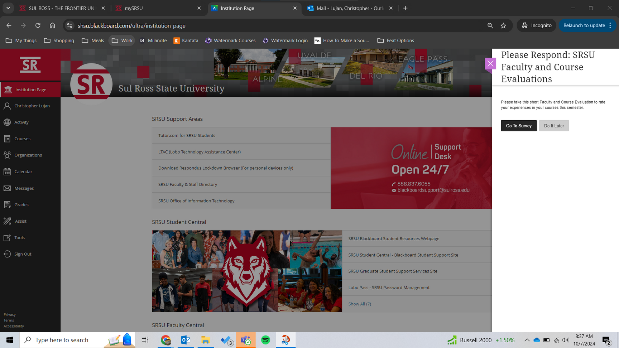
STUDENT EXPERIENCE
Once students open Blackboard they are immediately met with a banner to complete their course evaluations.
Students have an option to “Do It Later” but that option will go away 3 days before the survey closes

Slide 5
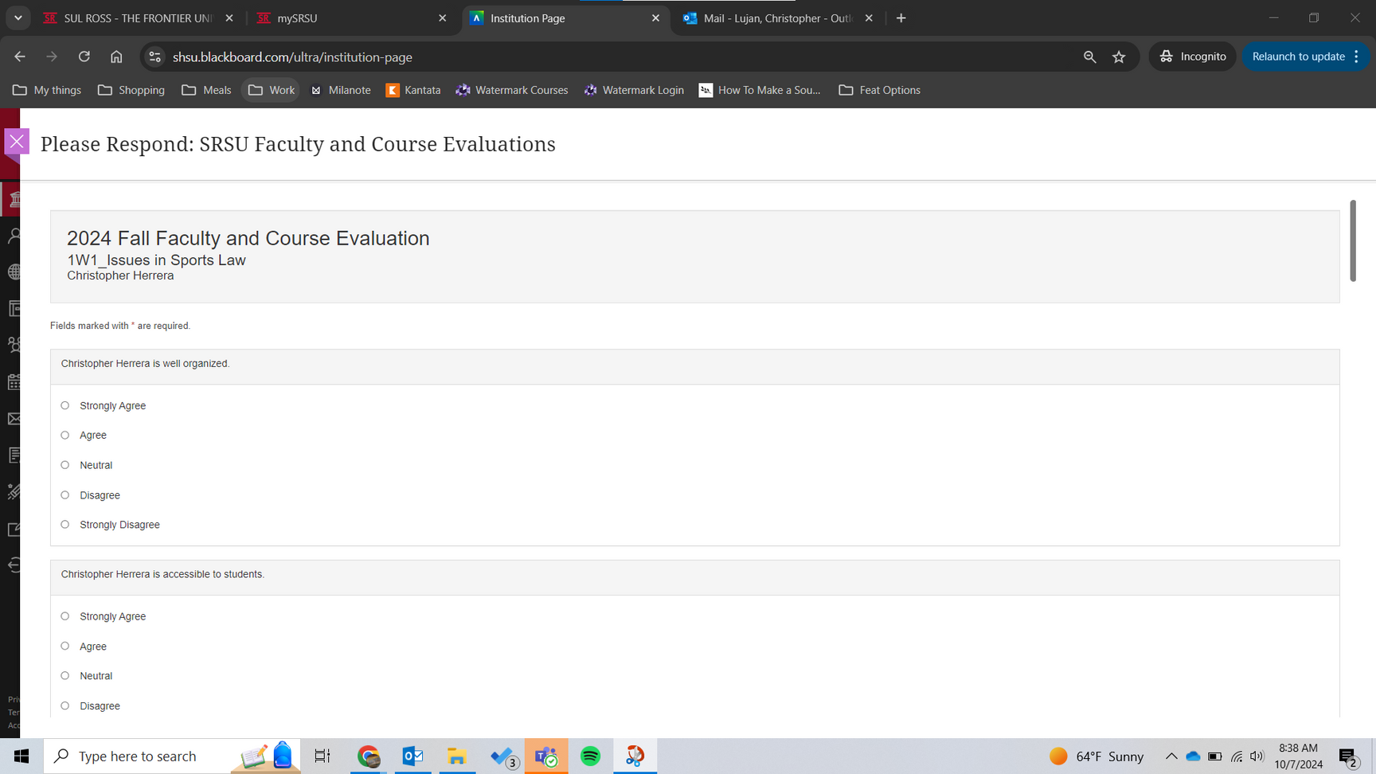
STUDENT EXPERIENCE
After a student selects a course the banner will open up to the survey itself where the 15 questions are asked.
If there are two professor teaching a course the questions will be separated with the ability to have a responses for individual professors .

Slide 6
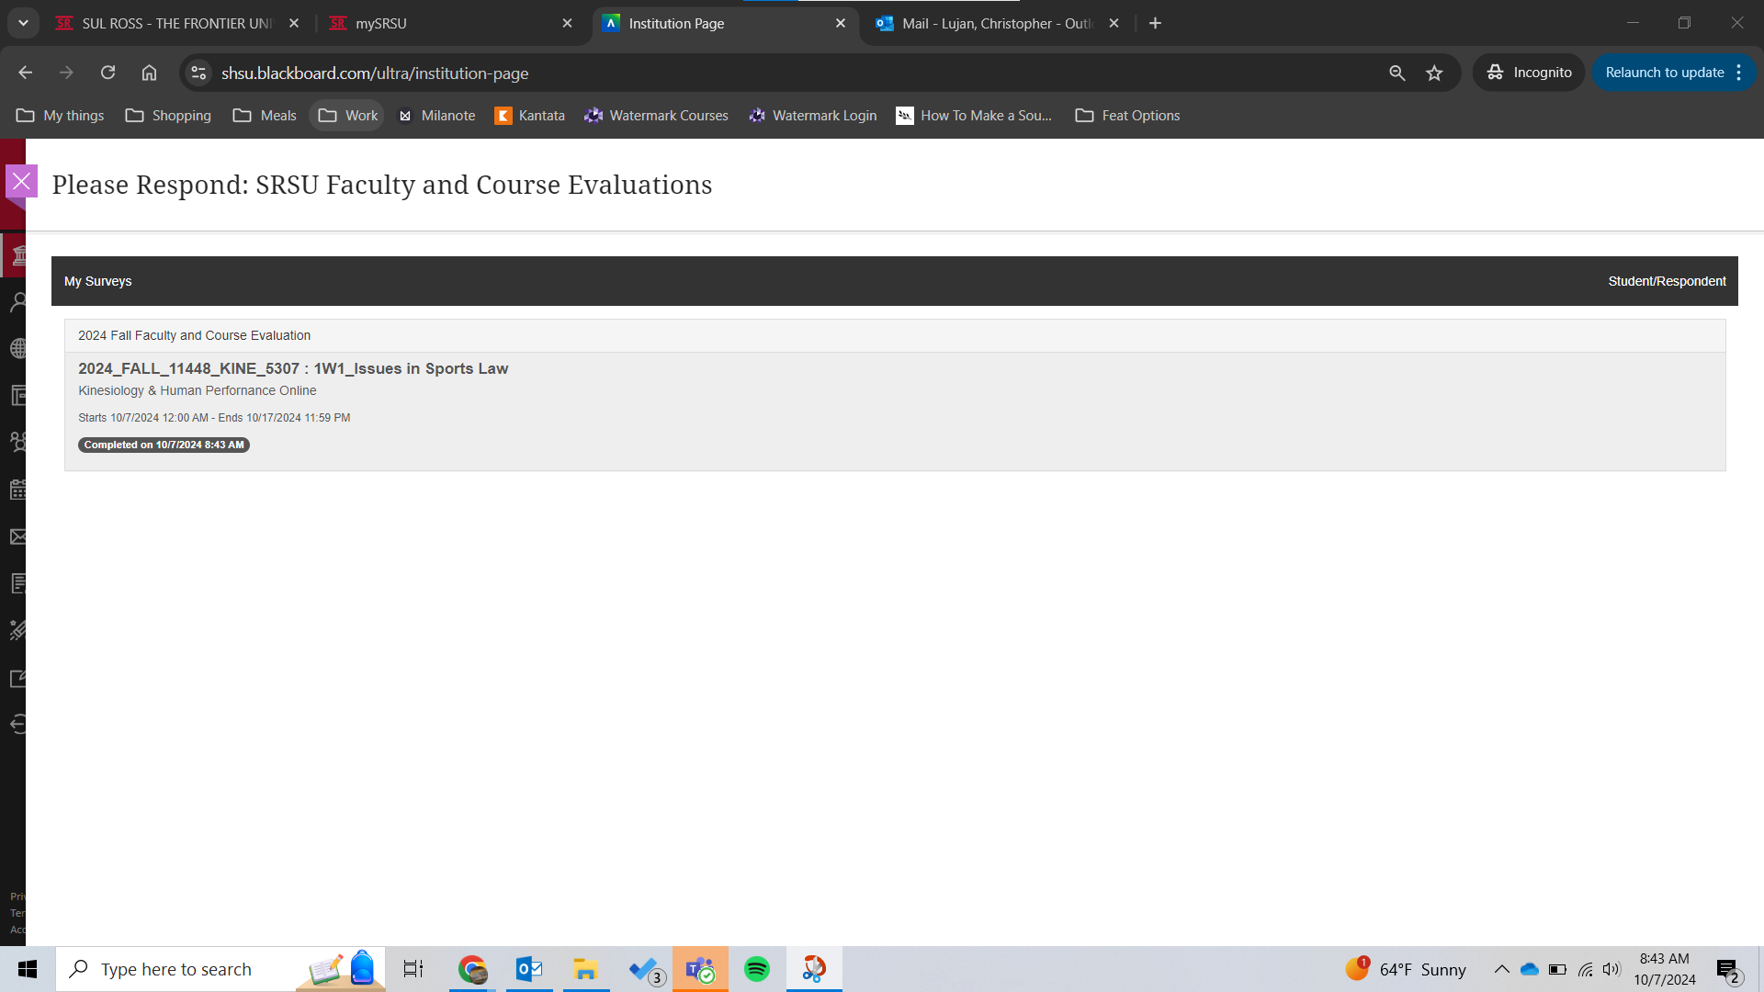
STUDENT EXPERIENCE
Upon completion the student will be brought back to all faculty and course evaluations they need to complete.

Slide 7
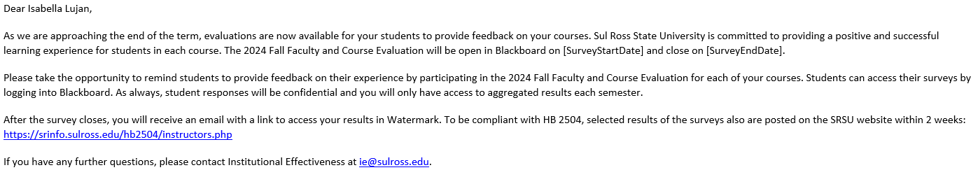
WHAT TO EXPECT EACH TERM
  An email will come from Provost 3 days prior to the survey opening with the subject “Faculty and Course Evaluations Open Soon”

Slide 8
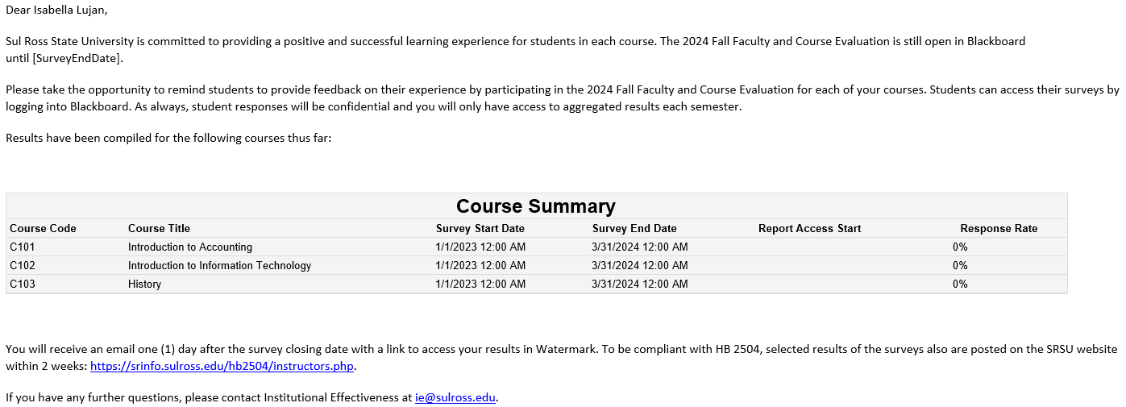
NON-RESPONDENTS
  Halfway through the administering of the survey an email will come from IE titled “Non-Respondents for 2024 Fall Faculty and Course Evaluations” containing a course summary chart indicating the percentage with which each of their courses have received student evaluation responses, this serves as a notice to remind your students

Slide 9

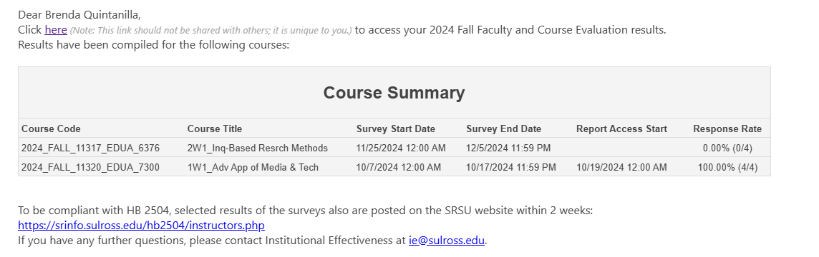
COURSE SUMMARIES
  Course evaluations will typically run for 10 business days.
  When the course evaluations close, faculty will receive an email “2024 Fall Faculty and Course Evaluation Results” with a link to view their completed term results in Watermark.

Slide 10
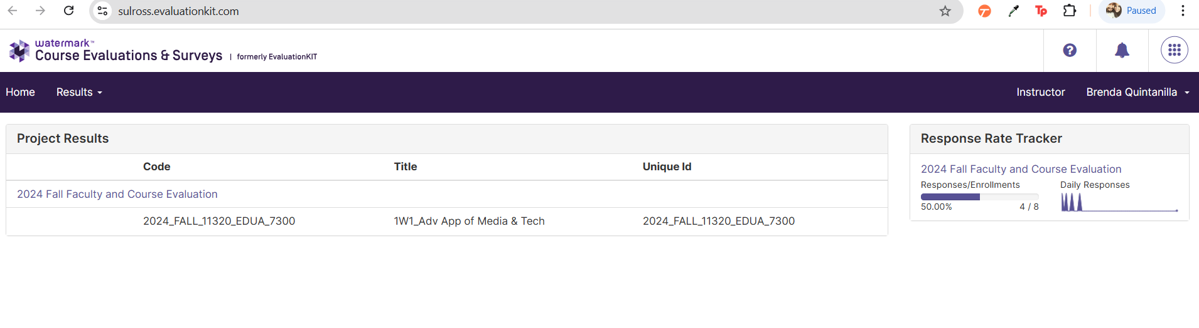
VIEWING RESULTS IN WATERMARK
Response Rate Tracker:
  This offers each faculty member a quick glance at their current term response rates.
  Since there is only one course listed under “Project Results”, the numbers in this section indicate how many students completed the evaluation for this course.
  If there were multiple courses listed the number would be greater.
Code:
CRN and Course ID in Blackboard
Title:
Course Name and Section
Unique Id:
Same as the “Code”

Slide 11
DOWNLOADING DETAILED RESULTS

Slide 12
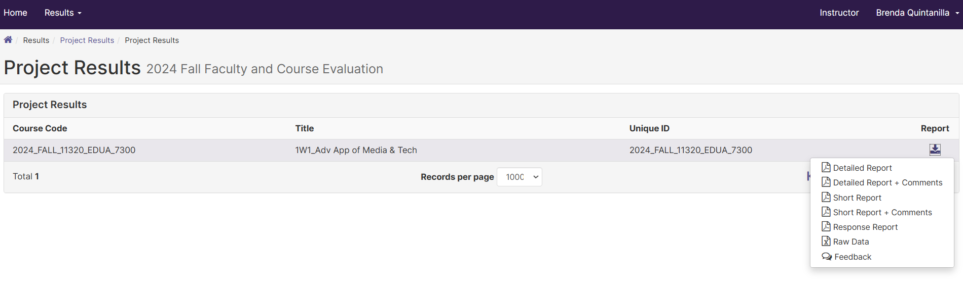
DOWNLOADING DETAILED RESULTS
This page looks similar to the one previously but will only show you the course evaluations that have been administered thus far in the semester. This means that if you’re checking the results in October/March for a first eight-week term course you will not be able to see the results for a second eight-week term or full sixteen-week term course until December/May.

Slide 13
TYPES OF REPORTS
Detailed Report
This will provide you a list of all responses, aggregated by question for the specific course that you are looking at. It will also provide you a mean average score at the end.
Detailed Report + Comments
Same as above but includes student comments.
Short Report
Small chart that reports the average score for each question.
Short Report + Comments
Same as above but includes student comments.
Response Report
Allows you to see individual responses and comments rather than aggregated summaries. You still cannot see which student said what but this allows you to see if there are comments associated with a low or high score for a particular response.
Raw Data
Used by the Office of Institutional Research to upload results onto the HB2504 site.
Feedback
This is a feature that allows Department Chairs and Deans the ability to comment on a specific course and faculty evaluation.

Slide 14
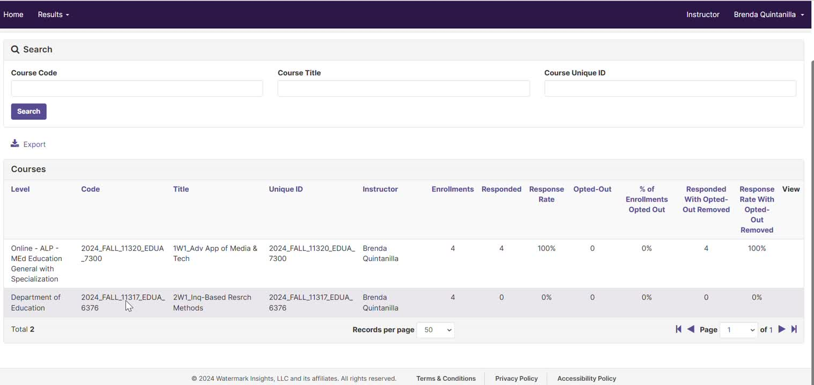
TERM METADATA
  View individual course list for the semester.
  Check enrollment count compared to those who responded.

Slide 15
RESULTS
Watermark
  Results will be available the day after the evaluation period closes.
  Results will start to stack up in the system separated by semester (i.e., Fall 2024, Spring 2025, etc.)
  A link will always be provided for you to review basic result information, but if you’d like a different report, you can use an Instructor Survey function. Training is available on the Institutional Effectiveness website for this resource.
  Deans and Department Chairs will have administrator rights to view all results and comments in Watermark. This resolves the need for APEX reporting.
Blackboard
  All prior results prior to Fall 2024 can still be viewed in Blackboard. APEX reporting and HB2504 reports will remain active.
  Instructors can access Watermark through Blackboard if needed.

