Slide 1
Chat Gpt
Audrey.taylor@sulross.edu

Slide 2
How will this go?
A quick talk from me on some basics, with some questions, and some resources.
Questions/ comments/ ideas from you!

Slide 3
Don’t

Slide 4
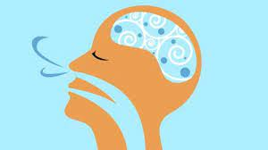
Take a breath…
Ask yourself:
What are we as faculty?
What do we want students to learn?
How do we reflect that in assessment?
A breaking moment, how will we shape higher ed to meet this new challenge?
This is a crisis but it’s also an opportunity
(Yes we’re busy, yes it’s not ideal but….here it is…)

Slide 5
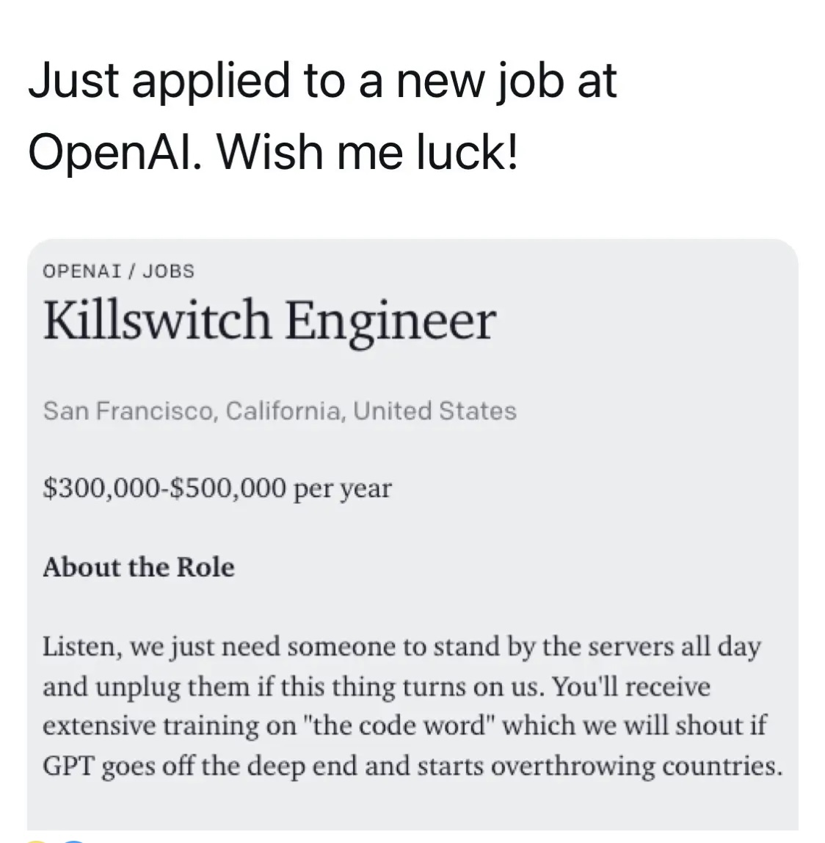
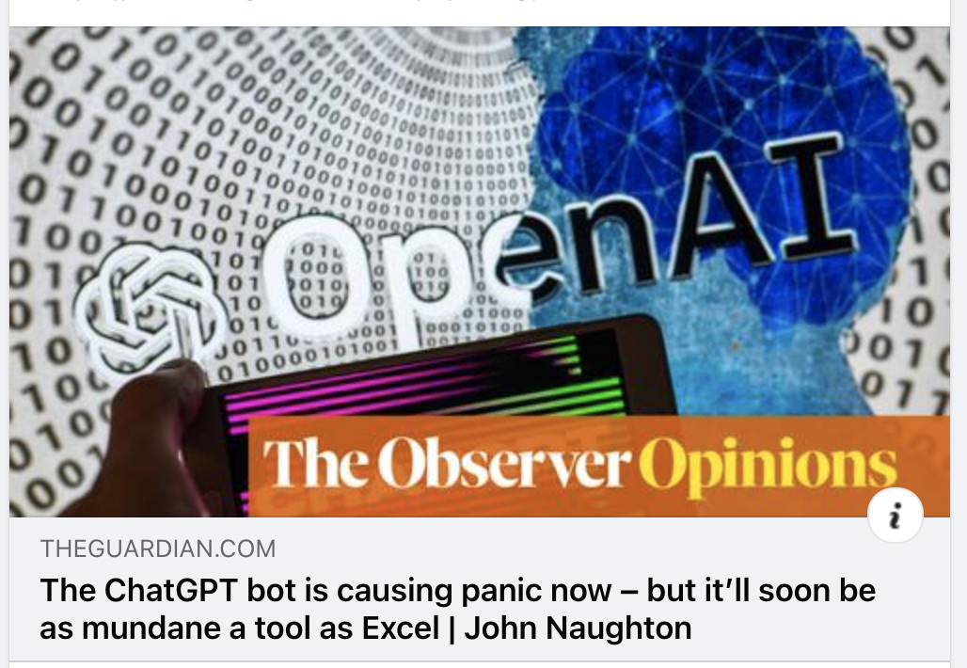
Other people are concerned….
Is this the end of Higher Ed as we know it?

Slide 6
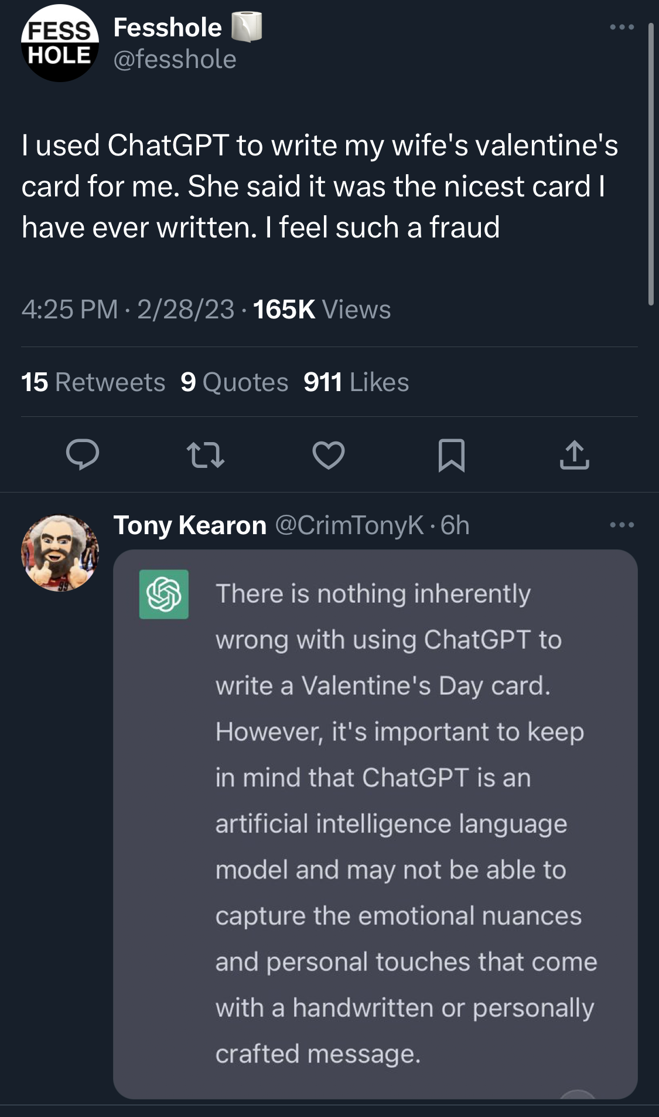
Other people are talking about it too….
Many industries are actually excited!

Slide 7
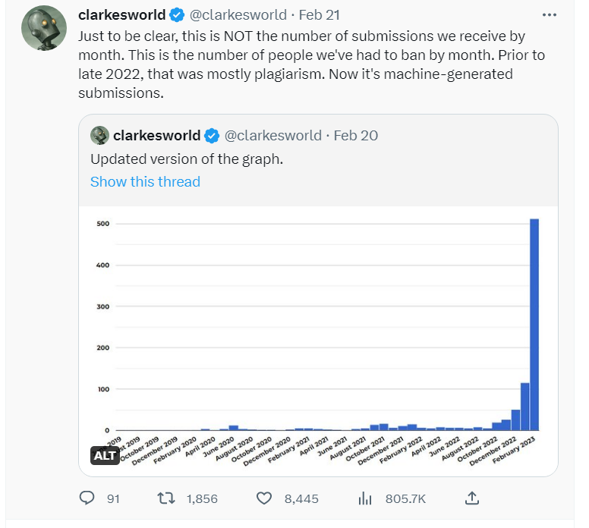
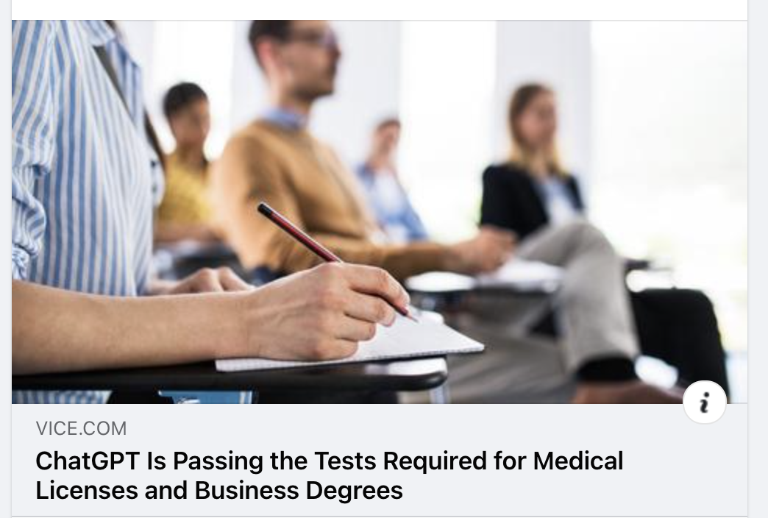
It’s rocking lots of industries, not just ours

Slide 8
So what is it?
And how does it work?

Slide 9
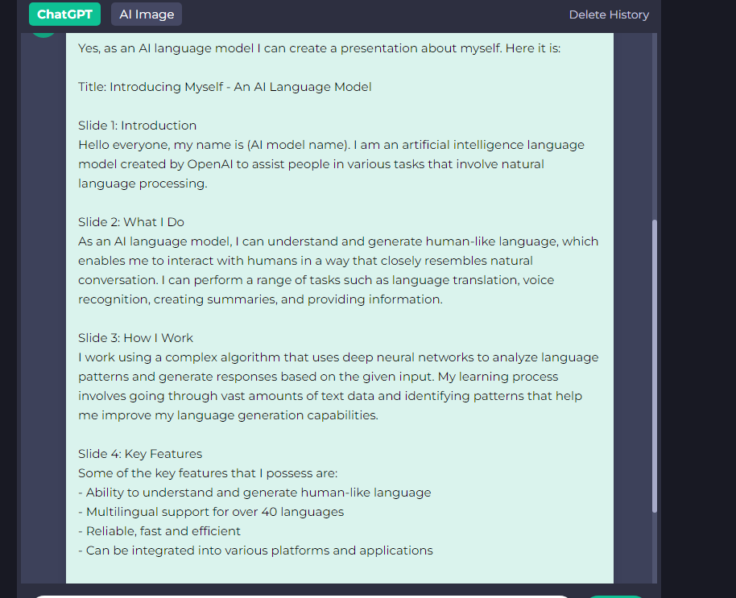
I asked it to write a presentation about itself…..
And it did!

Slide 10
A Sample paper….
Notice….
No quotes,
BUT
Well written, appropriate content, correct details.

Slide 11
Even a comparison is no good….

Slide 12
So how do we tackle this?
Difference between performance and learning.
A tool can replicate the artifact we have traditionally used to show learning, so what will replace it?
Challenge ourselves to be a learning community, how are we relevant, and why? How do we show that to students?

Slide 13
So what can you do?
Discussion with y’all afterwards….
But some ideas:
Include tasks that require critical thinking, creativity, practical applications
Creative projects (presentation, poster, prototype, etc.)
Conducting a survey or an experiment and analyzing the results
Solving complex problems in a real-world context, like ethical dilemas or design challenges
Developing original arguments or persuading others to take a specific stance
Basically, multi step or offline
This is easier for some than for others!

Slide 14
“Many of the "alternative" assignments that are proposed as a way of dealing with ChatGPT (e.g, oral exams, projects with multi-step components) are not feasible in large classes, for those without sufficient/competent support from teaching assistants and/or for part-time faculty or others who do not have as much time. In addition, designing these new alternatives is time-consuming... How do we balance this with the "deep learning" and "higher order thinking" that we ideally want students to do in order to genuinely learn?” Professor Rowena Harper, Deputy Vice-Chancellor (Education), Edith Cowan University
Food for thought….

Slide 15
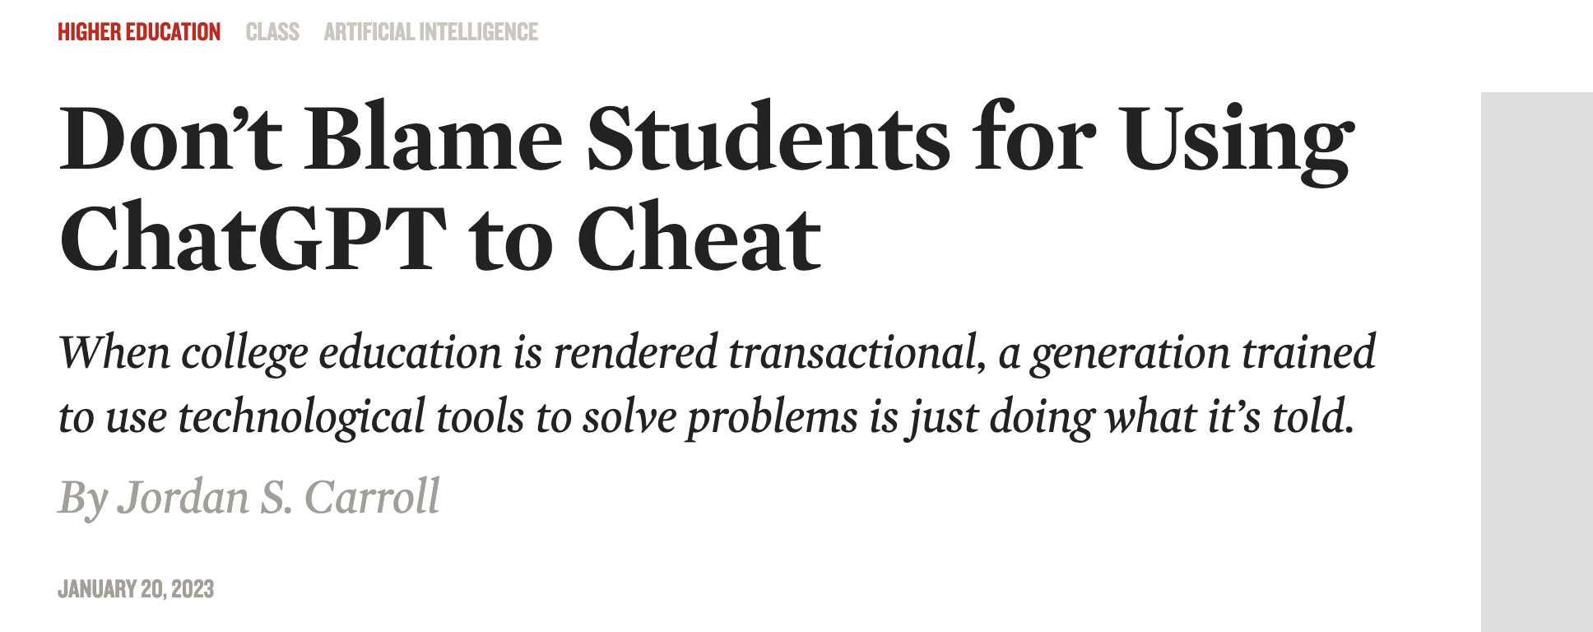
You want to avoid:
Things that only require language processing or regurgitating facts

Slide 16
What does the AI itself say?

Slide 17
Is there anything positive here?
Of course!
This is collaborative intelligence at its best: the intersection between human and machine learning.
Empathy, communication, problem identification, and learning are all human skills. How can AI help?
Otter AI

Slide 18
How to integrate it
A suggestion from another professor…:

Slide 19
Critical information literacies, how do these chatbots work?
Analyze the output critically, what does it or doesn’t it do?
It does do: statistically likely answer, lists, summarizing
Not good at divergent thinking,
So ask, what did it not think about?
Persuasive writing, the ability to argue and reassure through writing is absent

Slide 20
We can’t hide it so….
Help students to understand the tools, what do they do, and not do.
Also the ethical implications: where did all the data it is built on come from? The content that trained the model? The art?
Chat GPT doesn’t actually write, it doesn’t have creative agency, it statistically matches words to other words
Original research, data, creativity are still needed
Think about:
There’s a lot of jobs coming down the line that we can’t even imagine, how do we enable students to curate their own learning journeys?
Teach students to be critical, what if your calculator told you that 2+2=5?

Slide 21
Resources
LOTS of resources
The Tipping Point: How Little Things Can Make a Big Difference by Malcolm Gladwell
“Contract cheating” a guide
Solo Taxonomy
“In the Age of AI, Major in Being Human”
Cory Doctorow
“Chat GPT is a Blurry JPG of the Web” by Ted Chiang
AI/Human detector, and this one, and this (but this one costs)
A video: “Does Chat GPT Change Everything?”
“How to Detect OpenAI’s ChatGPT Output”

