Slide 1
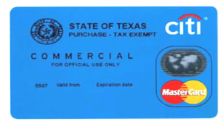
Sul Ross State University P-Card Training
In Association with Sam Houston State University (SHSU)

Slide 2
P-Card Policy/Guide (PUR-08)
The purpose of the Sul Ross State University (SRSU) Procurement Card (P-Card) Program is to establish an efficient, cost-effective method for paying for others and to delegate the authority & capability to make these purchases to the end-user in amounts not exceeding single transaction and monthly limits.
The P-Card Program will be administered in accordance with the terms of the State of Texas contract with Citibank and the University Purchasing Policy and Procedures.
The P-Card is intended to complement existing processes-not to avoid or bypass appropriate purchasing procedures or bidding requirements.

Slide 3
The Procurement Card
All items available through a SRSU preferred contract/supplier in the SHSU supported BearKatBuy should be utilized first, before going outside the tool and using the P-Card.
In addition to internal policies and procedures, Sul Ross State University (SRSU) will comply with the terms and conditions of the State contract.
When SRSU Policy contradicts Procurement Card Policy, SRSU Policy prevails.
Travel expenses are NOT allowed with the P-Card.

Slide 4
P-Card Issuance
The individual and dept. head will need to complete the New Procurement Card Order Form to obtain approval.
The P-Card is issued in an individual (Delegate) name with approval from the dept. head with the wording ‘Official Use Only’ clearly indicated on the card.
The Delegate must bring his/her photo I.D. to SRSU Procurement Office before the P-Card will be issued.
The P-Card will only be issued to the individual listed on the card once it is verified that the individual has taken P-Card Policy and Procedure Training.
The Delegate will sign the P-Card Agreement, which will be kept on file in the Card Services Administrator’s office.
Your signature on the Procurement Card Agreement shows that you understand the intent of the program and agree to follow the established policies and guidelines.

Slide 5
Security of the Card
Delegates are responsible for the security of the card and card number.
Treat with the same level of care as you would your personal card.
Please ensure the Procurement card is kept in a secure location.
DO not post in a work area.
Do not leave on file with vendor.

Slide 6
SHSU Card Services Admin
Sam Houston State University Card Services Administrator is the SRSU point of contact for the P-Card Program and is responsible for the following:
Establish University Policies related to the Program
Training on policies, procedures and reconciliation
Monitor and maintain documentation of P-Card activities
Determine compliance with University policies and procedures through auditing of all Expense Reports and attached documentation
Answer day-to-day questions
Establish and update restricted Merchant Category Codes
Audit accounting detail and makes dept. aware of necessary corrections to be made through the SRSU Accounting and Finance office

Slide 7
SRSU P-Card Delegate
A Delegate is an authorized faculty or staff member who has permission to make purchases on behalf of the dept. in accordance with the policies. Delegate responsibilities:
Follow all P-Card policies, procedures, rules, and guidelines outlined in the Procurement Card Policy and Procedures
Must attend P-Card Training
Adhere to the Delegate limits approved
Secure the card in a safe place at all times
Submit monthly Expense Report through the Citi tool by the 15th of each month
Ensure all necessary documentation related to purchases made with the P-Card are retained

Slide 8
P-Card Controls/Credit Limits
All P-Cards will have departmental spending limits.
Purchases in excess of these limits will be denied at the point of sale.
Payment Cycle Limits will limit the dollar amount available toward purchases during a single reporting cycle.
Transaction Spending Limits = limits the total dollar amount available toward a single purchase. The Transaction Limit allowed is $2,000
Includes the purchase price, plus freight and installation.
Payment Cycle Limits = limits the total dollar amount available cardholder can spend monthly.

Slide 9
Credit Limits
The dept. should request a Payment Cycle Limit consistent with the anticipated use of the card, up to a maximum limit of $5,000.
Any requests for a monthly credit limit increase over $5,000 will require approval by the Dean, Appropriate VP/Provost, Vice President for Budget and Finance, and SHSU Procurement/Business Services.
Raising your limit over $5,000 monthly increases SRSU’s liability in the case of fraudulent charges and this liability will ultimately be the responsibility of the dept. and departmental O&M funds should it be determined that negligence was involved in any fraudulent activity.
Request for Procurement Card Credit Limit Increases Form located at:
https://d1zyo2o8kyjaow.cloudfront.net/wp-content/uploads/2020/12/request_for_p-card_credit_limit_increase_-_sul_ross.pdf

Slide 10
P-Card Controls/Restricted Vendors
Vendors are assigned a Merchant Category Code (MCC) based on the type of business they operate.
Four-digit # assigned to a business by a bank or institution when the business begins accepting credit card payment.
The P-Card Program is restricted from use with certain types of suppliers and merchants. If the P-Card is presented for payment to these vendors, the authorization request will be declined.
If this happens and the purchase is within guidelines, call the SHSU Card Services Administrator while still at the vendor’s place of business during normal working hours M-F 8:00 a.m. to 5:00 p.m.

Slide 11
Lost/Stolen Cards
If a P-Card is lost or stolen, the Delegate must immediately contact Citi Customer Service at 1-800-248-4553.
After contacting Citi, notify:
Univeristy Police
SHSU Card Service Administrator
SRSU Account Manager/dept. Head
Prompt, immediate action will reduce the possibility of fraud activity.
The Account Manager may be required to reimburse SRSU for any charge resulting from failure of the Delegate to immediately report the loss or theft of a card.
The dept. may be subject to suspension or termination of the dept. procurement card for failure to report the card lost or stolen.

Slide 12
Lost/Stolen Cards
Any fraudulent charges made on a lost or stolen card should be reported to the University Police Department and the SHSU Card Services Administrator.
The SHSU Card Services Administrator will report fraudulent activity to Citi to file a dispute and to the Office of Audits and Analysis if such fraudulent activity is related to purchases made by an employee of SRSU.
Keep in mind that the department may have to pay the full amount of card charges and work through the legal system to receive reimbursement.

Slide 13
Delegate Transfer/Termination
It is imperative that in either of the following cases the Department Head or his/her designee ensure that the SHSU Card Services Administrator is notified.
Upon Delegate transfer to another University Department
Upon Delegate termination from University employment
Upon Delegate assigned to new job or duties and no longer responsible for P-Card
The Department Head is responsible for determining the account number for any outstanding charges. Any fraudulent charges made after a Delegate termination from employment at the University should be reported to the University Police Department and the SHSU Card Services Administrator. The SHSU Card Services Administrator will report such fraudulent activity to the Office of Audits and Analysis.

Slide 14
Card Termination & Cancellation
Privilege does not come without responsibility. Use of the credit card is a privilege that carries a great deal of responsibility.
Abuse of the P-Card can result in immediate consequences with no appeal. Certain P-Card violations and infractions will result in strikes against the dept..
Three strikes will result in review of the card by SHSU Procurement and Business Services and the SHSU Associate Vice President of Finance and Operations for possible suspension, deactivation or termination or additional training of delegates with the SHSU Card Services Administrator.

Slide 15
Card Termination & Cancellation
Immediate Card Cancellation:
Results in cancellation with no option to receive another card.
Items purchased for personal use when determined to be intentional abuse or fraud.
Use of the P-Card to secure a cash advance.
2nd lost or stolen card within 3 years after the 1st lost or stolen card.
_____________________________________________________________________________
Immediate Card Deactivation:
Results in a waiting period of 3-6 months for re-activation.
Expense Report not completed by the required date for 2 consecutive months or 2 months during a 6-month period.
Splitting purchases to avoid purchasing procedures (2nd offense).
Failure to provide documentation within the requested timeframe for an audit.
Use of the P-Card for travel related expenses or failure to have erroneous travel charges credited back to the P-Card.

Slide 16
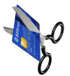
Other Card Cancellations & Actions
Non-use
If the dept. has not used the procurement card within one year, the P-Card will be cancelled.
Termination of University Employment or Transfer to a Different University Dept.
When a Delegate terminates employment with the University, the dept. head has specific obligation to notify the SHSU Card Services Administrator PRIOR to the termination date, so the card can be cancelled.
Transfer to a Different University Dept.
When a Delegate changes employment from one University dept. to another, the dept. head has specific obligation to notify the SHSU Card Services Administrator PRIOR to the effective date of change.

Slide 17
Other Card Cancellations & Actions
Failure to promptly report a lost or stolen card
If a dept. fails to make a report of a lost or stolen card immediately, the dept. may be required to reimburse SRSU for any fraudulent charge made on the card until it has been cancelled.
SRSU will pay the charges and the dept. will be required to reimburse the University.
Subject to a minimum 3-month waiting period before a new card will be issued and Delegate will be required to attend training again.
Administrative Authority
The dept. Head or supervising Dean, Vice President, or President has the authority to request that the SHSU Card Services Administrator deactivate or cancel a dept.’s card at any time for any reason.
Any card so deactivated or cancelled may be reactivated or a new card issued with approval by the position that originally requested the deactivation or cancellation.

Slide 18
Making a Purchase
Determine if the transaction is an acceptable use of the card.
Splitting purchases to avoid purchasing procedures or bidding requirements is not allowed.
Consider available contracts for best value: State Contracts, TX-MAS.
Contracts, DIR Contracts, Tex-An Contracts, and Cooperative Contracts.
Always consider Recycled Products.
Accepting Free Gifts with purchases is strictly prohibited with the P-Card.
See examples of Acceptable and Unacceptable Purchases.
Determine if the transaction is within dept.’s spending limit.
A transaction includes the purchase price, plus freight & Installation (No Tax as SRSU is tax exempt)
Taxes charged must be paid, dept. will be responsible for obtaining a credit from the vendor. If unable to secure a credit from the vendor, dept. must reimburse the amount of the sales tax to the Univeristy.

Slide 19
Making a Purchase
Consider making purchases with WorkQuest (formerly Texas Industries for the Blind and Handicapped-TIBH)
Items available through Work Quest must be considered when using state & local funds.
Products by Persons with Disabilities – A preference shall be given to manufactured products of workshops, organizations, or corporations whose primary purpose is training and employing persons with mental or physical disabilities, if the products or services meet state specifications as to quantity, quality, and price.
When utilizing treasury/appropriated funds, and the purchase(s) or service(s) can be provided by Work Quest, they will be purchased through Work Quest or justify in writing the reason for the rejection and forward the rejection letter to Procurement.
https://workquest.com/about/

Slide 20
Consider HUBs
Identify the vendor
State law mandates, on both state and local accounts, that SRSU make a good faith effort to increase business with Historically Underutilized Business (HUB).
At least 51% of ownership of the business is by a woman, ethnic minority or a disabled veteran and they actively participate in the business.
Contact the SHSU HUB Coordinator, SHSU Card Services Administrator or your SHSU Purchaser for help identifying certified HUB vendors.
HUBs may be searched at the State of Texas CMBL search site:
https://www.window.state.tx.us/procurement/prog/cmbl/

Slide 21
Franchise Tax Status
State law mandates that PRIOR to the commitment of funds the Delegate verify the vendor’s hold status for any purchase EXCEEDING $500.
Verification can be made at the Comptrollers website:
https://mycpa.cpa.state.tx.us/coa/Index.html
The Taxpayer Identification Number can be found in Banner using FTMVEND
Expenditures utilizing state funds, MUST have the verification page attached to the Citi Expense Report

Slide 22
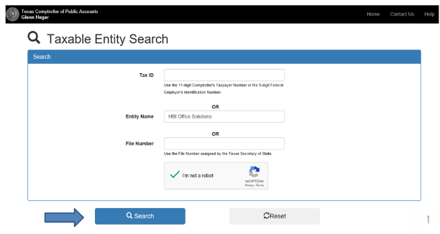
Franchise Tax Status
https://mycpa.cpa.state.tx.us/coa/Index.html
Enter vendor name in Entity Name filed then click the blue Search button.

Slide 23
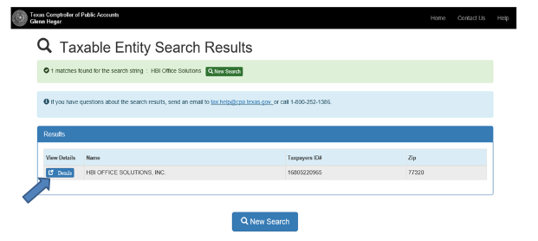
Franchise Tax Status
https://mycpa.cpa.state.tx.us/coa/Index.html
If vendor name found, click the blue Details button.

Slide 24
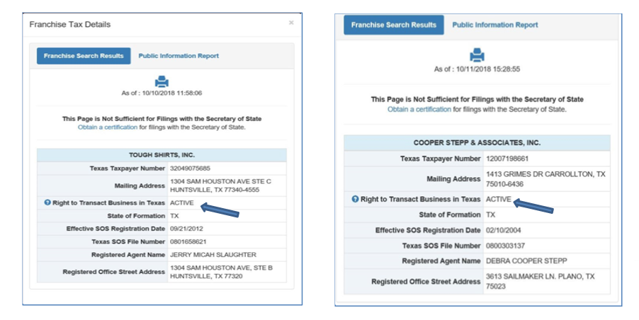
Franchise Tax Status
https://mycpa.cpa.state.tx.us/coa/Index.html
Franchise Tax Status displays.
If Active, Franchise Tax Ended, or Vendor Not Found, proceed with purchase.
If “Forfeited,” cannot use vendor and must find another one with item or service you need.

Slide 25
Making a Purchase-fax, phone, online
Visit the vendor or place the order over the Internet if you feel that the site is secure.
Confirm pricing including shipping and installation, excluding tax,
The P-Card identifies SRSU as being a tax-exempt entity of the State of Texas but does not automatically result in the charge being tax exempt.
Stress to the vendor that SRSU is tax exempt.
Provide detailed shipping instructions, including the building room number where the delivery is to be made.
Request that the dept.’s name and delivery address appear on all packing lists and box labels.
Secure required documentation, to fully document the purchase.

Slide 26
Making a Purchase
Secure a receipt or invoice to fully document the purchase and if applicable. If a receipt is not available, a P-Card Missing Receipt/Documentation/Problem Resolution Form is needed to document any problems associated with the purchase.
https://d1zyo2o8kyjaow.cloudfront.net/wp-content/uploads/2020/12/missing_receipt._doc._problem_resolution_-_sul_ross.pdf
This document will need to accompany the expense report.
Screen prints are acceptable for Internet orders; pricing MUST be reflected on the printout.
Always instruct the vendor to send the receipt/invoice directly to the dept not to Accounts Payable for P-Card purchases. A state agency may not pay for goods before their delivery to the agency. Vendors should only charge the account when goods are shipped.
All receipts/invoices or online printouts must reflect pricing.
Ensure receipt of goods and follow up with vendors to resolve any delivery problems, discrepancies and/or damaged goods.

Slide 27
Acceptable Purchases
Tools/Hardware/Janitorial/Safety Supplies
Books/DVDs/Reference Materials/Subscriptions/Periodicals
No E-Books
Decorations (SRSU sponsored events only)
Fabric/Linens/Uniforms
Fertilizer (smaller applications)
Flowers for non-University Sponsored Events
Food/non-alcoholic beverages
Freight (associated with P-Card purchases)
Furniture below $5,000 (non-inventoried) and not otherwise prohibited
Gifts/Awards
Gratuity (up to 20% is allowable)
Services (Maximum of $500)
Computer Supplies Per SRSU policy with IT
Registration for conferences, webinars, seminars
Membership Dues
Small Equipment (Not capitalized or controlled)
Pesticiedes/Plants/Landscaping Supplies
Promotional Items
Rentals (Signed Agreements/Terms and Conditions require prior approval)
Restaurants
No alcohol of any kind may be purchased unless Exception granted prior to purchase
Advertisements

Slide 28
Unacceptable Purchases
Alcoholic Beverages
Ammunition
BearKatBuy
Cash Advances/Cash Refunds
Cell Phones
Charitable Donations
Controlled Hazardous or radioactive materials
Fines & Penalties
Free Gifts
Fuel for Automobiles (Voyager Fuel Cards)
Gift Cards (See Achievement of Awards Policy)
High Risk Items Controlled By SRSU: Firearms, Historical Treasures & Works of Art
Insurance Premiums
Leases
Personal use items
Phone Cards
Prescription Drugs/Controlled Substances
Printers
Printing
Professional and Consulting Services
State Defined Controlled Equipment
Equipment with a single unit of $500 to $4999.99 Must be tracked due to the nature of the items.
Travel Related Expense
Registration is not considered a travel expense.
Registration purchased with P-Card should be reconciled on the P-Card Expense Report only. DO NOT include on your Travel Report.

Slide 29
State Defined Controlled Equipment
Stereo Systems
Cameras
TV’s, VCR/DVD Players
Two-Way Radios
Camcorders
Microscopes
Microcomputers, Servers and Laptops
Data Projectors
GPS
UPS Battery Backup
Scanners
Monitors
Please contact SRSU Property Office with questions.

Slide 30
Returns and Credits
Should a problem arise make every attempt to first resolve the issue directly with the supplier
Contact the supplier and obtain instructions for return. Note that some suppliers may charge a restocking or handling fee for returns
Review of future statements is vital to ensure the account is properly credited for returns, credits and disputed charges.
Returned, credited or disputed charges must be documented on a P-Card Missing Receipt/Documentation/Problem Resolution Form
https://d1zyo2o8kyjaow.cloudfront.net/wp-content/uploads/2020/12/missing_receipt._doc._problem_resolution_-_sul_ross.pdf
This document will need to accompany the expense report.
Sales tax is not a disputable charge through Citi.

Slide 31
Disputed Charges
If a charge on a monthly statement is inaccurate, the Delegate may choose to dispute payment by disputing the charge on a Citi Cardholder Dispute Form
https://d1zyo2o8kyjaow.cloudfront.net/wp-content/uploads/2020/12/citi_cardholder_dispute_form.pdf
All disputed charges must also be detailed in Chrome River on a P-Card Documentation Form.
The Dispute Form MUST also be scanned to SHSU Card Services Administrator at srsupcard@SHSU.edu and will need to accompany the expense report.
If disputed, Citi will place the charge in a ‘State of Dispute’ and the account may be given a provisional credit until receipt of adequate documentation from the vendor is provided.

Slide 32
Disputed Charges
If the documentation appears to be in order, the transaction will be re-posted to the account and the dispute considered closed.
If the charge is suspected to be fraudulent, the card will be immediately blocked. An investigation of the charge will continue, and a new card will then be re-issued to the dept.
The Card Services Administrator will report fraudulent activity to Citi to file a dispute & to the Office of Audits & Analysis if fraud activity is related to purchases made by an SRSU employee.
The dept. may have to pay the full amount of card charges and work through the legal system to receive reimbursement.

Slide 33
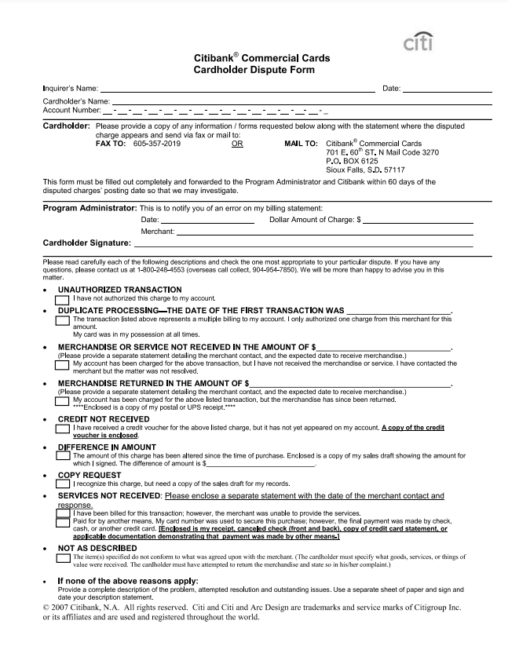
Cardholder Dispute Form
https://d1zyo2o8kyjaow.cloudfront.net/wp-content/uploads/2020/12/citi_cardholder_dispute_form.pdf
Form must be completed and filed with Citibank within 60 days from the statement billing date of any disputed charge.
Formal disputes processed through Citibank are allowable only when an error was made by the vendor.
An error made by the cardholder cannot be formally disputed.
Taxes are not disputable

Slide 34
Required Documentation
Each Delegate is responsible for retaining documentation on each purchase and submitting with their expense report.
Each Delegate is responsible for documenting transaction detail entries into Citi monthly.
Each individual purchase must be detailed electronically, showing a detailed description, selecting the correct account codes to which the charges apply, and the associated amounts.
Delegate will be responsible for making corrections through the Controller’s office after the 20th of the month if reports are submitted with incorrect tiles/codes.

Slide 35
Required Documentation
ACCEPTABLE PAPER DOCUMENTATION FOR EACH TRANSACTION MAY INCLUDE BUT IS NOT LIMITED TO:
Sales Receipts/Invoices or printed Internet or email confirmation (always required). All documents, printed Internet or email confirmations must reflect pricing on the printout.
Credit Receipts/Slips/Invoices must reflect pricing.
P-Card Documentation/Problem Resolution Forms.
Citi Disputed Item Form.
Other information or correspondence related to the purchase.
The State of Texas has determined that there is no excuse for missing receipts.

Slide 36
Monthly Statement, Reconciliation
The Delegate must complete all transaction detail entries in Citi and reconcile the entries with the Citi Expense Report.
All transaction detail entries related to charges on the Citi Expense Report must be completed on or before the 15th day of the month following the reporting cycle close date.
If the 15th of the month falls on a weekend, the Expense Report should be submitted by the first workday of the following week.
Delegates may begin reconciling P-Card expenses on the 6th of the month.
It is the Delegate’s responsibility to resolve all discrepancies, prior to submitting the report.

Slide 37
Reconciliation and Approval
A Procurement Transaction Log is the required method for expenditure tracking while using the P-Card. The form is available at:
https://d1zyo2o8kyjaow.cloudfront.net/wp-content/uploads/2020/12/srsu_p-card_transaction_log1.pdf
Delegate is required to be able to perform Citi reconciliation to ensure that transactions are reconciled and submitted by the required deadlines.
It is the Dept. Head’s responsibility to review the transaction listed on the Citi Expense Report to verify that all purchases are appropriate expenditures for the department and account charged.
Changes or corrections cannot be made in Citi once an expense report has been submitted and approved.
Delegates will be responsible for making corrections through the SRSU Accounting and Finance office after the 20th of the month.

Slide 38
Audits
Monthly statements, Citi Expense Reports and associated documentation will be audited by the SHSU Procurement and Business Services Office.
It is the Delegate responsibility to ensure all documentation is uploaded in Citi for each transaction.
If during an audit of the Expense Report additional information is requested, the Delegate will have 48 hours to respond and provide requested documentation.
Audits may be conducted in 1 of 2 ways:
The Card Services Administrator will contact the Delegate requesting an audit review.
The Card Services Administrator may visit the Delegate without notice and request an immediate review.

Slide 39
P-Card Payment
SRSU has selected a Citi reporting cycle of 30 days with payment due in 30 days.
SRSU’s statement closing date will be the 3rd day of the month or the 1st business day before, if the 3rd falls on a weekend or holiday.
At the end of each reporting cycle the Delegate MUST reconcile and submit a Citi Expense Report no later than the 15th of the month.
No exceptions, unless notified by the SHSU Card Services Administrator.
Only 1 monthly report should be submitted for the cycle within Citi.
There will be no late payments to Citi. Payment will be made from the department FOAP’s even if there is insufficient budget.

Slide 40
P-Card Payment
SRSU receives a summary billing listing all transactions for that period.
Payment will be made from a clearing account and all charges posted to the FOAP identified in Citi or the department’s primary O&M account, if no draft report exists in Citi with FOAP information.
The departments will be responsible for filing a Citi Disputed Item Form with Citi for all disputed charges, & for cleaning up any deficits with SRSU Accounting and Finance Office when an insufficient fund balance is present upon posting of charges.

Slide 41
Contacts
SHSU Card Services Administrator
LaTonya Fletcher
Email: srsupcard@shsu.edu
(936) 294-1991
Citi Customer Service 1-800-248-4553
SRSU Purchaser
Katie Luedke
Email: kxr085@shsu.edu
(936) 294-4673

