Slide 1
Records Management
Sul Ross State University
Spring 2023 Training

Slide 2
Learning Objectives
Attendees will be able to identify state records in their office and across the institution.
Attendees will be able to accurately read and use the Records Retention Schedule (RRS).
Attendees will be able to identify state e-records in their offices and the accurate disposition procedures for such records.
Attendees will learn skills for developing sustainable organizational processes for their departments.

Slide 3
Today’s Roadmap
Vocabulary Review
Record
Records Management
Records Retention
The Records Retention Schedule (RRS)
Electronic Records (e-Records)
Disposition and Archival Process of Records
Departmental Accession Planning
Record Inventories

Slide 4
Definition: Records Management
“Records management” is the application of management techniques to the creation, use, maintenance, retention, preservation, and destruction of state records for the purpose of improving the efficiency of recordkeeping, ensuring access to public information under Chapter 552, and reducing costs.
The term includes:
The development of records retention schedules;
The management of filing and information retrieval systems in any media;
The adequate protection of state records that are vital, archival, or confidential according to accepted archival and records management practices;
The economical and space-effective storage of inactive records;
Control over the creation and distribution of forms, reports, and correspondence; and
Maintenance of public information in a manner to facilitate the access by the public under Chapter 552.

Slide 5
What is considered a “record”?

Slide 6
Definition: State Record
“State record” is any written, photographic, machine-readable, or other recorded information created or received by or on behalf of a state agency or an elected state official that documents activities in the conduct of state business or use of public resources.
The term does not include:
Library or Museum material made or acquired and preserved solely for reference or exhibition purposes;
An extra copy of recorded information preserved only for reference;
A stock of publications or blank forms;
Any records, correspondence, notes, memoranda, or other documents, other than a final written agreement described by Section 2009.054(c), associated with a matter conducted under an alternative dispute resolution procedure which personnel of a state department or institution, local government, special district, or other political subdivision of the state participated as a party, facilitated as an impartial third party, or facilitated as the administrator of a dispute resolution system or organization.

Slide 7
Shortcut: How to Identify the Records in Your Office
Use the H – A – L – F method
H – Historical
A – Administrative
L – Legal
F – Fiscal

Slide 8
Shortcut: What is not a State Record?
Library or Museum material made or acquired and maintained solely for reference or exhibition purposes.
Example: books, reference materials, or artifacts.
An extra copy of recorded information maintained only for reference.
Example: printed budget books available in the Library and Archives, final graduation programs.
A stock of publications or blank forms.
Both physical and electronic forms.

Slide 9
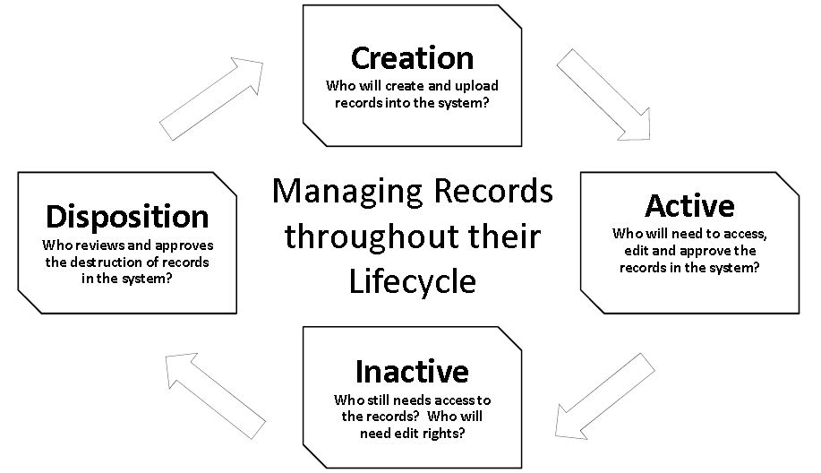
Managing Records Through Their Lifecycle

Slide 10
TSLAC and SLRM
Texas State Library and Archives Commission (TSLAC)
The organization that maintains state records and history.
State and Local Records Management (SLRM)
The department within TSLAC that maintains records management laws and practices for all state and local agencies.
tsl.texas.gov

Slide 11
What Does it Mean to be in Compliance with the State Records Management Laws?
University Requirements:
Update the University’s Records Retention Schedule (RRS) every five years.
Maintain some kind of Records Management program at the institution.
Allow state employees access to training, tools, and other resources necessary to maintain compliance.
Individual Requirements as a State Employee:
Follow the requirements established within the Records Retention Schedule within the department and individual records.
Note: departments have the ability to adjust the RRS to their needs
Practice effective management techniques.
Follow all of the disposition and records retention deadlines established by the State of Texas.

Slide 12
How do records management practices help State employees?

Slide 13
Benefits to Practicing Records Management
Textbook Answer:
Those in compliance with the State Records Management laws will be insured against the following:
Natural Disaster
Audits
Legal implications against the University
Theft (Physical and Cyber)
Practical Answer:
Increased organization according to the most recent Records Retention Schedule.
Centralization, enhanced visibility, and transparency within departments and across the University.
Total understanding of the work that individuals and departments produce for the institution.
Preservation of the history of the University, to include individual impact.
Protection against the threat of non-compliance.

Slide 14
Definition: Records Retention & Records Retention Schedule
(b) The records retention schedule must list the state records created and received by the agency, propose a period of time each record shall be maintained by the agency, and provide other information necessary for the operation of an effective records management program.
Government Code, Chapter 441, Subchapter L, Section 441.185

Slide 15
Records Retention Schedule
Any written, photographic, machine-readable, or other recorded information created or received by or on behalf of a state agency.
The continued possession and control of something.
A plan for carrying out a process.

Slide 16
Overview: Records Retention Schedules
Required to be reviewed and updated every five years.
Updates are allowed at the request of the institution.
Though large updates happen every five years, changes may be requested at any time.
Sul Ross has kept the pattern of dividing the Schedule (RRS) by departments, which is not a requirement and not common across all State universities.

Slide 17
How to Read the Records Retention Schedule (RRS)
The current schedule is from 2020. It will be updated in 2025.

Slide 18
Definitions
Agency Code: The unique number assigned to Sul Ross by the State of Texas.
Agency Name: Sul Ross State University
Agency Item Number (AIN): Used to quickly identify the record by the department. This number is set by Sul Ross, not TSLAC.
Record Series Item Number (RSIN): Official identification code used by all State of Texas Universities in their RRS. These will not change and are not unique to Sul Ross departments.
Record Series Title: Name given to describe the records being identified in the RRS. Can either be standard (set by TSLAC) or unique to the University (i.e. La Vida Lobo Records).
Description: Either a copy of the definition given by the State or a unique definition applicable to the department.
Retention Code: The type of retention required for the record. See next slide.
Retention: Retention is expressed in years unless otherwise noted.
AC Definition: If the retention code AC is used, it will always have a definition.
Archival: Short, code used to reference if the record should be archived or reviewed by the University Archivist before disposition.
Remarks: Any further notes pertinent to this record will be written here.
Legal Citations: This column contains citations to applicable federal or state laws or regulations affecting retention.

Slide 19
Explanation of Codes: Retention Codes
All numbers used with retention periods are expressed in years unless otherwise indicated.
AC – After Closed (or terminated, completed, expired, or settled)
The record is related to a function or activity with a finite closure date.
AV – As Long as Administratively Valuable
The immediate purpose for which the record was created has been fulfilled and any subsequent need for the record to conduct the operations of the university, if any, has been satisfied.
CE – Calendar Year End
December 31
FE – Fiscal Year End
August 31
LA – Life of Asset
The record is retained until the deposit of the asset.
PM – Permanent
A record that possesses enduring legal, fiscal, or administrative value and must be preserved permanently by the university. Always double-check these records, to see if they have an archival code associated with them.
US – Until Superseded
The record is replaced by an updated version. If a record subject to this retention period is discontinued or is no longer required by law, the date of supersession is the date the decision to discontinue the record is made or the law takes effect. If the record relates to an employee, the date of supersession is the date of termination or the last date the record is needed with reference to the employee, as applicable.

Slide 20
Explanation of Codes: Archival Codes
I - The records must be transferred to the institutional/university archives for long-term preservation.
O – The institutional/university archives must be contacted for an archival review of the records before disposition. Those records determined to be archival must be transferred to the institutional/university archives for long-term preservation.

Slide 21
Organization: Managing Physical and Electronic Records
Should be customized to each office with standard practices.

Slide 22
Filing Systems
“a planned method of classifying and arranging records for storage and retrieval.”
There is not a standard filing system to which all Texas state agencies must adhere, but each agency is responsible for determining the best method of filing records in all storage formats that the agency creates and maintains.
What are some examples of storage formats that SR uses?

Slide 23
Why Adopt a Filing System?
You cannot manage your records if you cannot find them.

Slide 24
What Makes an Effective Filing System?
1. The system should be simple and easy to use.
The simpler the filing system is, the more user-friendly it will be. It should reduce errors and facilitate the use of the system, making the filing process second nature to the employee.”
2. The system should be transparent.
Does your filing system make sense at first glance? Is your system integrated into the department and university needs?
3. The system should be effective.
Does your filing system work for your department? The university? Determine how records are used and accessed in your office to help create something that will be easily followed by current and future employees.
4. The system should ensure fast and accurate retrieval of information.
How long does it take you to find important records in your office?
5. The system should account for the efficient use of resources.
Having a user-friendly filing system allows for the most effective use of resources in an office. If your files are in order, you will be able to eliminate spending extra money on large quantities of filing supplies and equipment, as well as not spend as much time, money, and effort looking for files when requested.

Slide 25
What Makes an Effective Filing System?
6. The system should reduce frustration.
When all of the files are in order, employees are less irritated because they know exactly where everything is and do not need to search through boxes, files, desk organization systems, or electronic files to locate a particular document.
7. The system should ensure full control of the records for the duration of their life cycle.
When files are mismanaged, records could be disposed of on accident or held past the time they are required. Good filing systems should help move your records from one step in their life cycle to the next.
8. The system should protect the department and university against legal actions.
Having a complete grasp of where your records are filed allows you the opportunity to access them in a timely manner in case of litigation or a public information request. It also shows a prosecuting legal team that you are actively maintaining your files in accordance with the law.

Slide 26
Ideas on Filing Arrangements
Alphabetic
You organize the records alphabetically based on the Record Series Titles.
You can also organize by items, not on the record retention schedule.
With this system, you will need to establish strict guidelines for everyone who accesses these records to ensure that there are no duplicates of information. Alphabetic filing systems run the risk of being too broad at times.
Alphanumeric
Pro: Numbers are less likely to be misfiled than letters and misfiles are easier to detect.
Con: You will need an index for this filing system.
With this system, you would organize files based on the fiscal, calendar, or academic year, and then by subject.

Slide 27
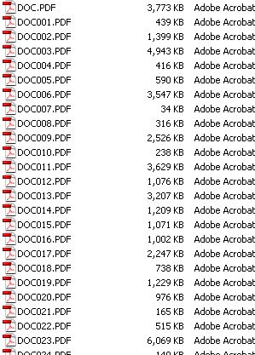
Unorganized Files: The Side Effects
Unorganized Files
Problem: Unorganized files do not allow employees to locate records in an efficient and timely manner.
Solution: Create a file plan. A file plan lists the records in your office, describes how they are organized and maintained.
Although this can be a seemingly long and time-consuming process at the beginning, the amount of time it will save in the long run will make it worth it.
The Lack of an Establish Labeling System
Problem: Not having a unified and consistent labeling system in place to allow for the standardization of filing is a problem.
Solution: Create your own labeling system. Suggestion… be mindful of the retention schedule and record contents, when selecting file names. This will assist with disposition and current use.
For paper filing systems, print labels rather than writing them to ensure transparency.
Avoid abbreviations that are unique to individuals and not the department or university.
Multiple Filing Locations
Problem: Same document filed in multiple locations. Across the department or campus.
Solution: Identify the true record holder and communicate that within the department or across campus.
Beware: Duplicate copies are not records until they become the only copy in existence.

Slide 28
Unorganized Files: The Side Effects
Where to File?
Make a decision and be sure to only file the record in one place. Use the file plan that you set up earlier to pick the location.
Keep the records that you access daily in a quick and convenient location.
No More Room?
Purge duplicate copies.
Consider the Records Retention Schedule to find things that can be disposed of.
Everyone’s a File Clerk?
This is when everyone in a department or multiple employees across campus maintains copies of the same record. In these cases only one individual is the record holder, the others maintain duplicate copies.
Solution: limit the access individuals have to your files so that your records remain organized and filed efficiently. However, keep transparency in mind when making these decisions.
Recommendation: Do not leave your records at the disposal of someone else.
Trouble Locating a File?
Create a manual or guide for your coworkers to know where they can find something located in your office or within the department. Ask your colleagues to let you know when they borrow a record.
Different Retention Periods in the Same Folder?
Problem: Managing and disposing of records with different retention periods that are held in the same file.
Solution: Create separate files for different retention periods to avoid confusion when disposing of records. If this is unavoidable, switch to a multi-part folder. By separating each record series out in a different part of the folder.

Slide 29
Separated Employees
When someone has given their two weeks notice
Ask these individuals to go through their physical and electronic records.
Share records with others to ensure a smooth transition of records.
Update all organization systems.
Go through emails and redirect to the supervisor for the time being.
Sudden separation or restructure of positions
The supervisor should ask someone within the department who has the most knowledge of the separated employee’s position to review their records.
Do not destroy any records (physical or electronic), including emails until someone has had time to review the records. This could be done by the next employee after they have been in the position for a while.

Slide 30
Electronic Files Management
The same rules apply

Slide 31
When is an Email a Record?
The sender copy is usually always the record copy and the sender is the custodian of the record copy.
Recipient copies are record copies if the person must take action based on the message or if the message is required to provide adequate documentation of any action.

Slide 32
Save vs. Delete
What to Keep
An email with content that directly relates to your job responsibilities or current projects.
Are you the custodian? This is the person responsible for maintaining records that are related to the email subject.
Rule of Thumb: if you sent an email in any official capacity (as an employee of Sul Ross), you’re probably the custodian of that email chain.
What to Delete
Junk mail, personal mail, or anything that has no relevance to your department’s business functions.
Courtesy copies: when you are cc’d for reference purposes but the general email thread doesn’t apply to your job responsibilities or current projects.
Convenience copies: in these situations, the record copy is maintained elsewhere but you have kept the email for reference (i.e. campus news).
Transmission emails: the only point of these emails is for an individual to send an attachment. You save the attachment (if necessary) and delete the email.

Slide 33
Organize and Classify
Your e-mails should be organized and maintained by content (job responsibilities versus information only)
The key to efficiently managing your email is to have a good filing system.
Use your retention schedule as a guideline and organize your emails while being conscious of retention periods.
Set up simple, easy to understand, and recognize names for folders and files.

Slide 34
I have hundreds of emails…
Identify your records (physical and electronic). Within the retention schedule, identify only those records that apply to you and your job responsibilities.
In setting up an email file plan, first, ask yourself what are your job responsibilities. Then, what kinds of emails do you send? What kinds of emails do you receive? Your answers should fall into three general categories: correspondence, management records (as applicable), and program records (those related to your specific job responsibilities).
So, start with your email. Obtain a copy of your retention schedule(s), develop your file plan, create email folders, and then classify and file your emails in both your Sent Items and Inbox.

Slide 35
Electronic Records
How does Records Management apply to electronic records?

Slide 36
Start with the source
Records include information found on machine-readable systems and devices.
Where can you find machine-readable records?
Emails (Sul Ross provided or other)
Hard drive
One Drive/Sharepoint/Teams sites
Website (mySRSU, SRInfo, or individual websites)
Databases (Banner, People Admin)
Mobile devices (apps that run through a department on campus)
Social media accounts
Text messages
Other?

Slide 37
Creating an Electronic File Plan
What should you address?
Creation of records (location, source, record-holders/custodians)
Retention and security (permanent disposition)
Retrieval (organization, location, and access)
When and how to destroy these records (RRS and electronic locations)
Consider the lifecycle of all records, especially electronic ones.
Creation of the record
Active use of the record
Inactive use of the record
Disposition of the record

Slide 38
Scans or Replicated Versions of the Original
Remember: There can only be one true record in use at one time. All others are duplicates. In an unorganized system, records may be disposed of on time but continue to exist because of the convenience/duplicate copies.
Going Digital
The scanned document will become your record once the paper copy is shredded. Note: This means that your electronic copy should be a true representation of what the physical record looked like.
Do not destroy both the physical and electronic copies prior to the disposition period.
Consider that it is a lot easier to delete an electronic file than shred a paper record.
If you scan all of your records you must maintain the system.

Slide 39
Creating an Electronic File Plan: Emails
Start with correspondence
Go through your sent folder.
Go through your inbox to see what pertains to your job responsibilities or current projects.
This is a practice. You will get faster at identifying email records the more you actively consider records management practices.
Determine if the email is administrative or general.
Administrative: you are not the record holder but you need these emails to assist in your job responsibilities.
General: applies to institution policies or updates and are not job-specific.
Classify the remaining emails according to the Records Retention Schedule.
Start with content
Go through your sent folder.
Go through your inbox to see what pertains to your job responsibilities or current projects.
Classify based on content according to the Records Retention Schedule.
If something does not fit, figure out what kind of correspondence it is.

Slide 40
Social Media and Text Messages
Social Media
A department’s social media may contain records if the page contains historical or administrative records that can only be found on social media.
Was Facebook used to publish original materials?
Text Messages
As state employees, your phone records fall under the Public Information Acts of the state of Texas. How do you avoid personal information being shared?
Avoid texting about work, especially in a negative way.
Avoid browsing social media or texting during work hours (as much as possible).

Slide 41
Disposition & Archival Process

Slide 42
Records Retention Disposition Log
The Disposition Log lists all of the records that individual departments have identified as having reached the disposition stage of the record lifecycle. Disposition is determined according to the Records Retention Schedule (RRS).
The Disposition Log is how Sul Ross determines to:
keep track of disposed records; and
demonstrate departmental compliance with records management laws.

Slide 43
Other Steps
Archival Requests
Long Term Storage Solutions
Departmental Inventories and File Plans
Mass Shredding Projects
Records Retention Schedule Updates

