Slide 1
How to enroll in a payment plan

Slide 2
Sul Ross State University offers students the option of enrolling in an installment payment plan during the long semesters (Fall and Spring).
The details of the plan may vary from semester to semester. Payment amounts are due in 4 installments.
Installment 1 - 25% of your balance, due on the Last day for late registration.
Installment 2 - 25% of your balance, due approximately 4 weeks after the first installment.
Installment 3 - 25% of your balance, due approximately 4 weeks after your second installment.
Installment 4 - 25% of your balance, due approximately 4 weeks after your third installment.

Slide 3
Sul Ross State University may offer students the option of enrolling in an installment payment plan during Summer which may be subject to change at any given time. Please check with the Bursar’s Office.
The details of the plan may vary from semester to semester. Payment amounts are due in 3 installments.
Installment 1 - 30% of your balance, due on the Last day for late registration.
Installment 2 - 35% of your balance, due approximately 4 weeks after the first installment.
Installment 3 - 35% of your balance, due approximately 4 weeks after your second installment.
You may enroll yourself in a payment plan by following these instructions.

Slide 4
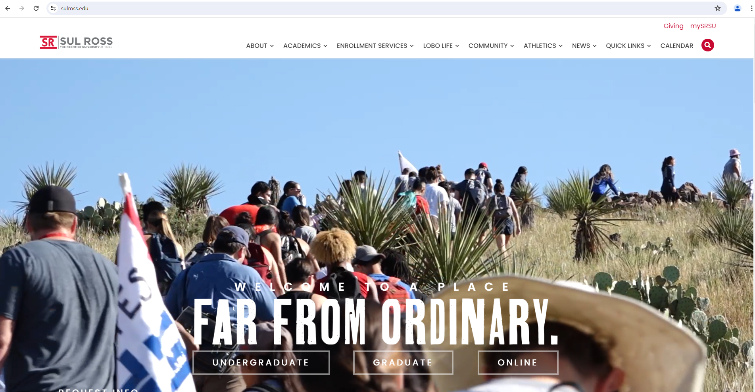
Enrolling yourself: Access the Bill+Payment Account Suite through mySRSU.
1. Search Engine: Type sulross.edu
2. Then click on the top right corner under “mySRSU”

Slide 5
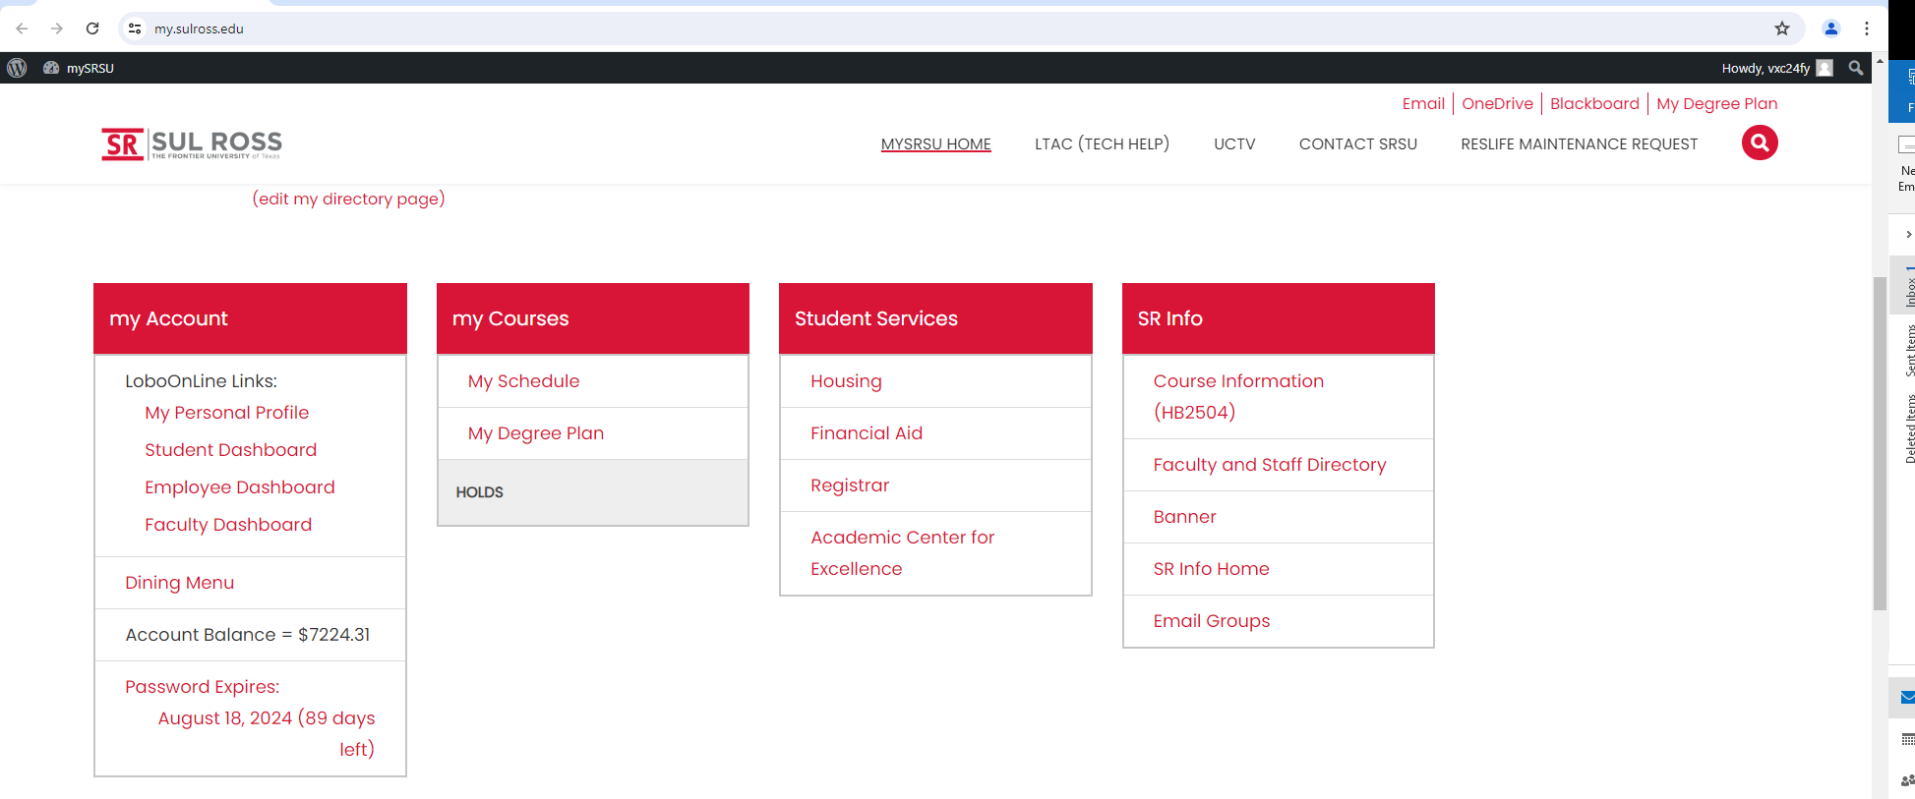
Click on “Student Dashboard”
New Lobo

Slide 6
New Lobo
Click on “Student Account Suite (Bill+Payment)”
New Lobo

Slide 7
Type in your credentials
“Username”& “Password”

Slide 8
Click on button “Continue to the Student Account Suite”

Slide 9
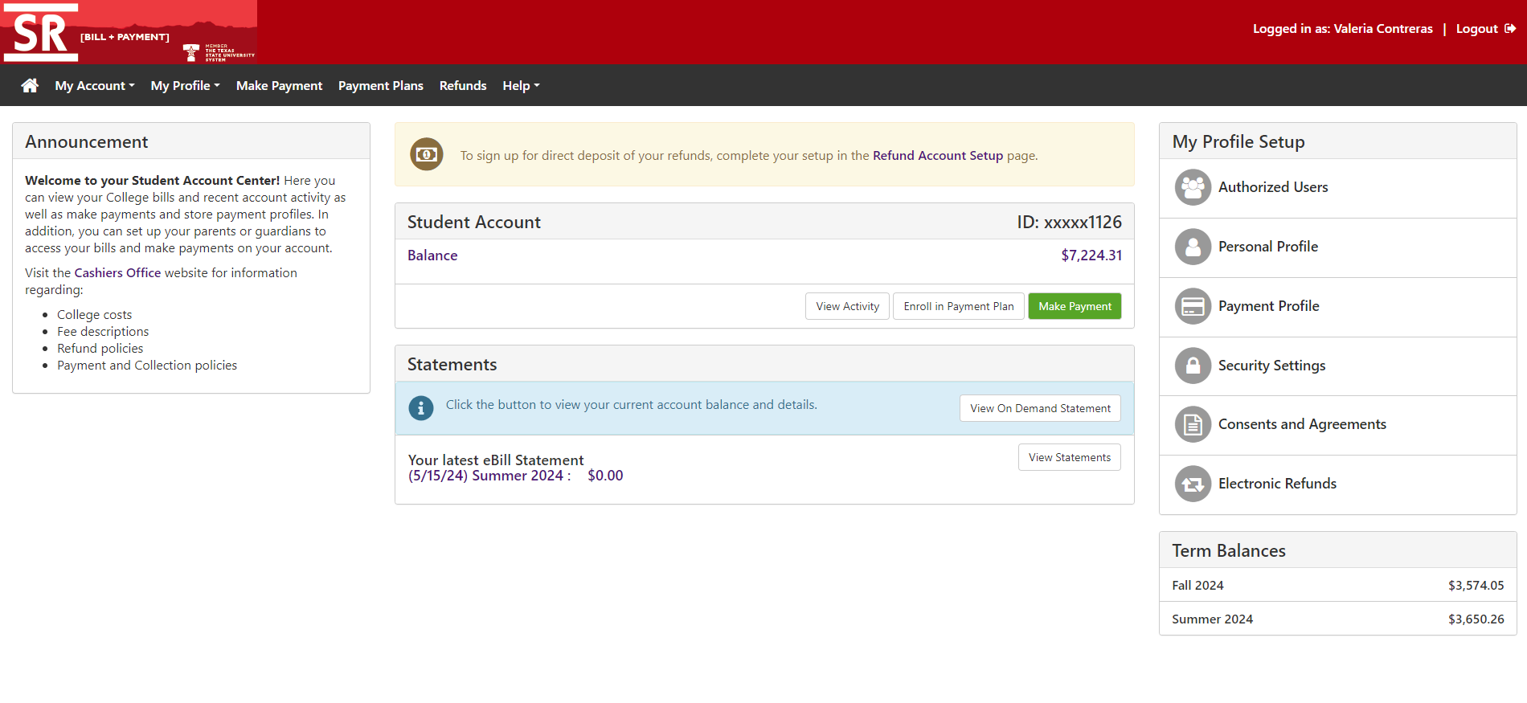
Click on “Enroll in a Payment Plan”
New Lobo

Slide 10
Select the term from the dropdown box.
New Lobo
2. After Reviewing click “Select.”
1. Additional fees that may be acquired.
Review details carefully on the “Details” button.

Slide 11
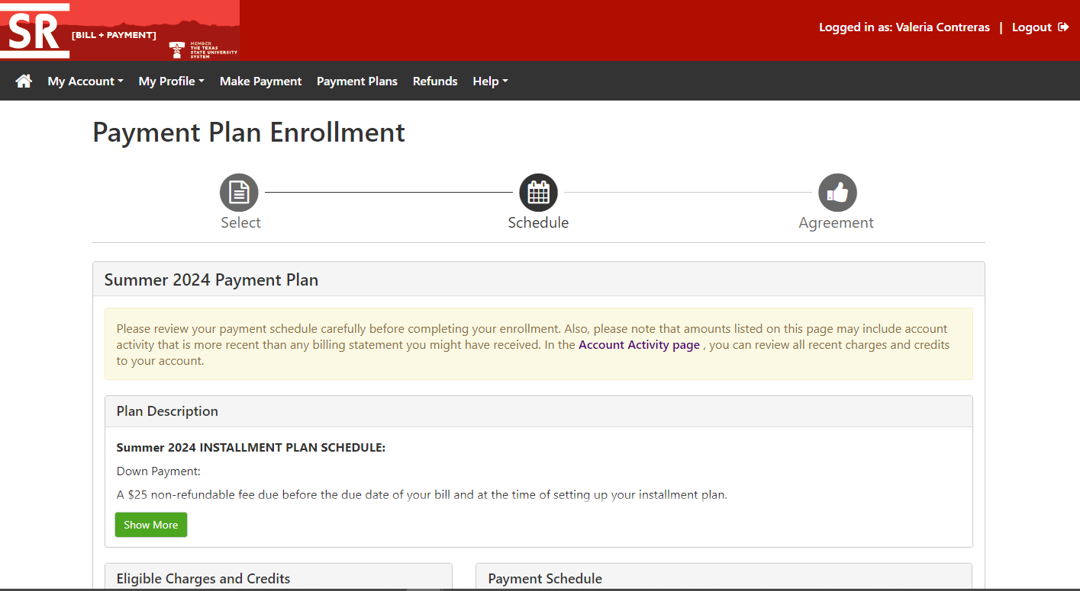
New Lobo
1. Read & Review
2. Click “Show More”

Slide 12
2. Installments and due dates associated with your payment plan are displayed. Please note:
• If you add or drop classes, these amounts will change.
3. These charges do not include estimated financial aid. If you receive financial aid, it will cover some or all of these charges, and your balance will be lowered accordingly.
1. Information regarding eligible charges and credits included on your payment plan.
4. Make your payment selection
5. After you review the full information click “Continue.”

Slide 13
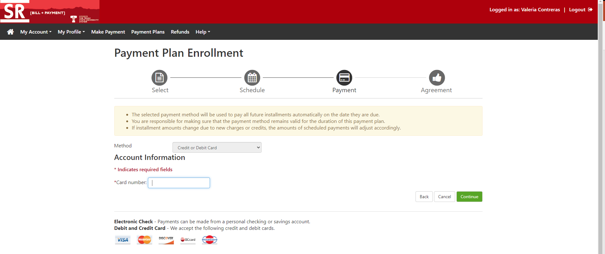
New Lobo
1. Chose Payment Method
2. Enter Information
3. Verify Information and Click “Continue”

Slide 14
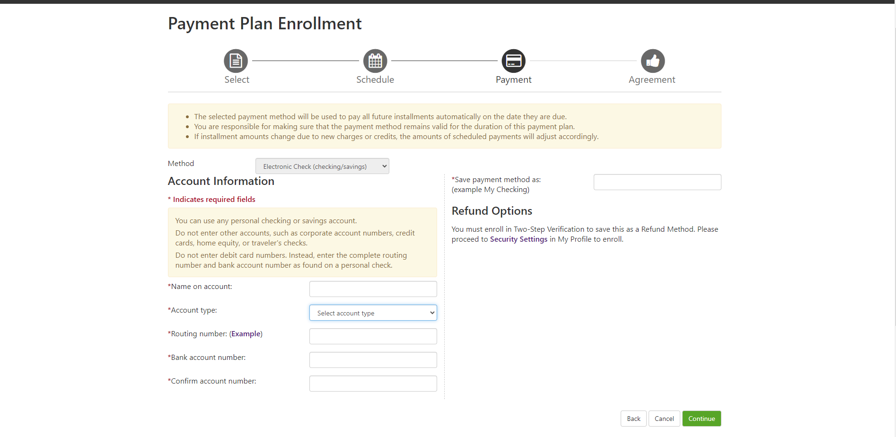
1. Chose Payment Method
3. Type in “nickname”
2. Enter Banking Information
4. Verify Information and Click “Continue”

Slide 15
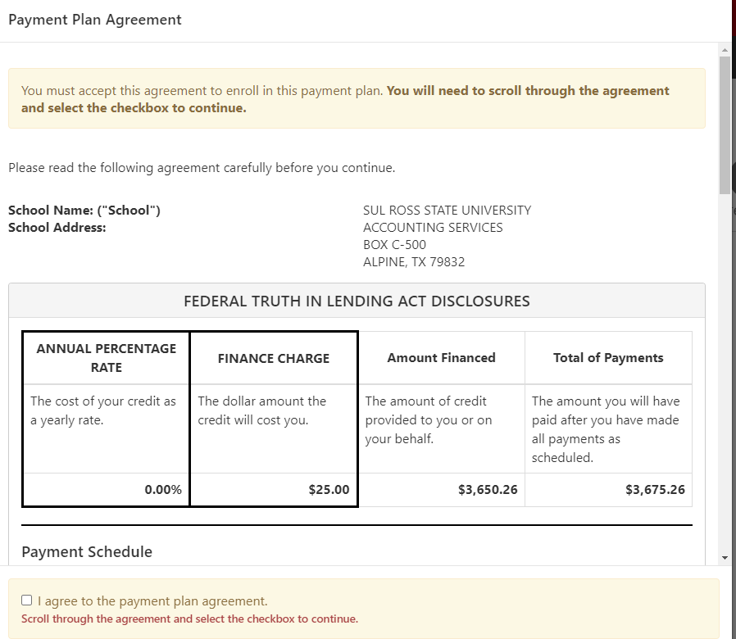
Read & Review Click “checkbox”

Slide 16
Contact Information
Bursar’s office Cashier’s office
Mickey Corbett | Bursar Terrie salas | head cashier
432-837-8056 432-837-8253
mcorbett@sulross.edu Cashiers@SulRoss.edu
Valeria Contreras- ar coordinator
432-837-8007
Valeria.contreras@sulross.edu
collections-alp@sulross.edu

