Slide 1
How to set up Refund-DIRECT DEPOSIT

Slide 2
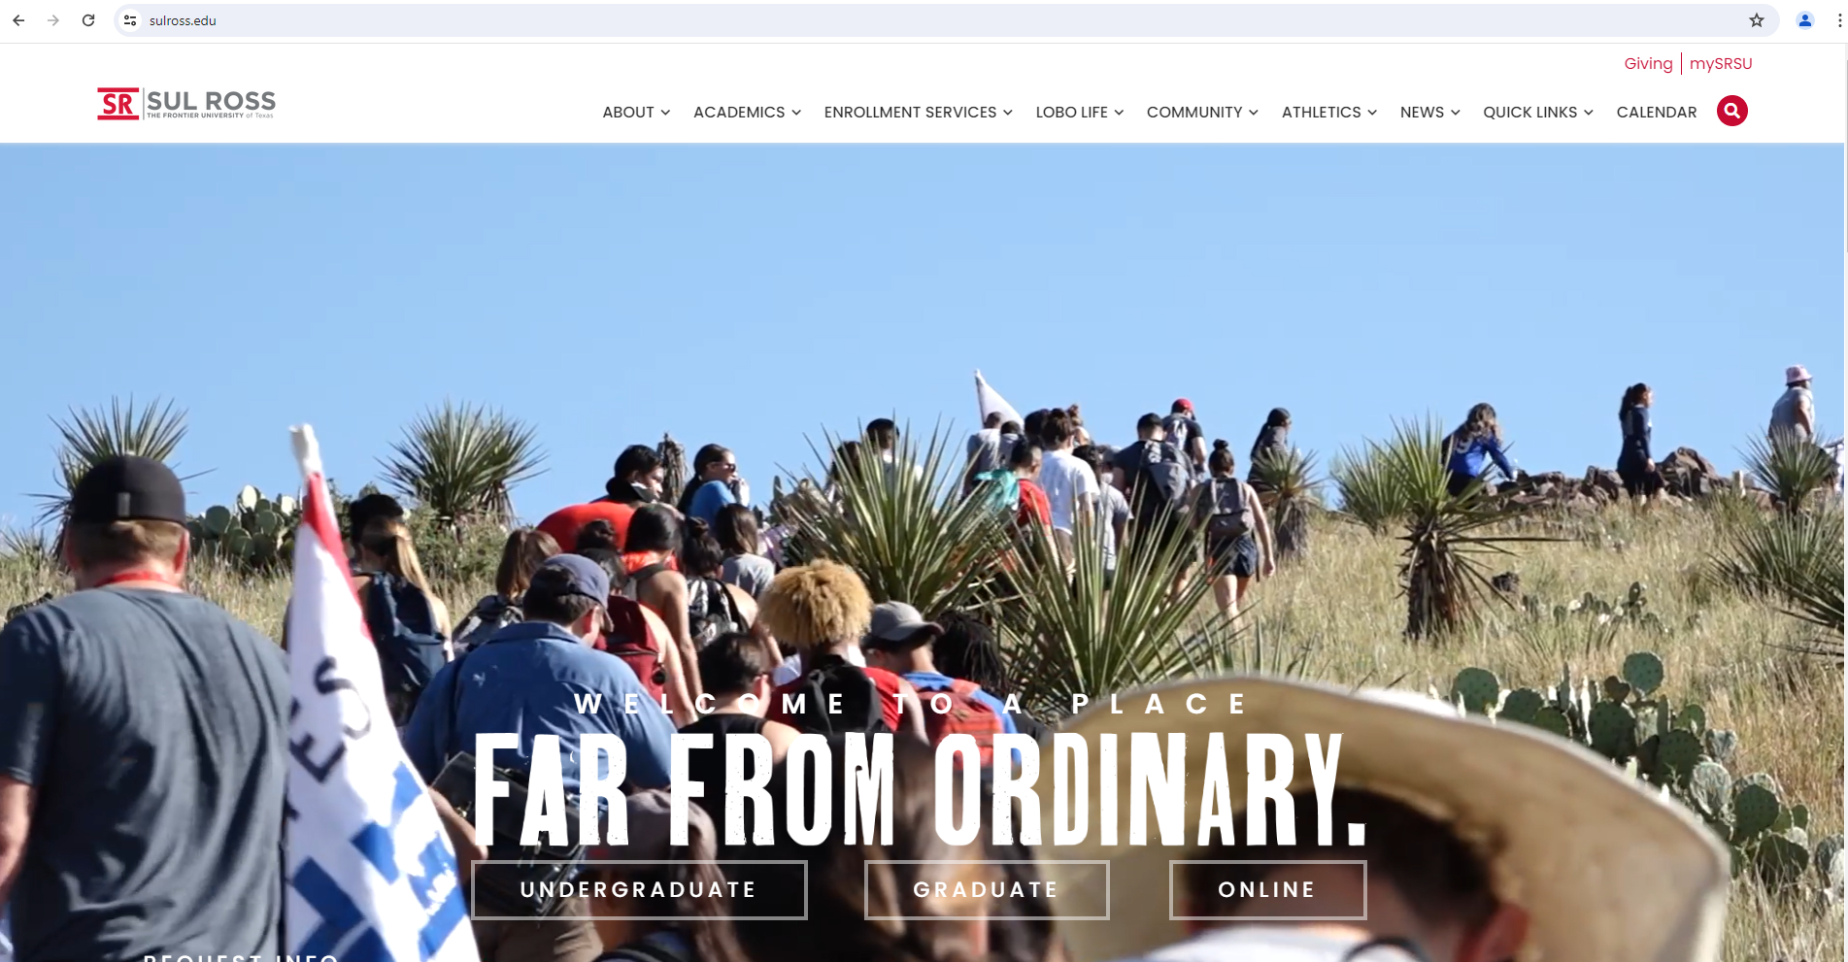
Access the Bill+Payment Account Suite through mySRSU.
1. Search Engine: Type sulross.edu
2. Then click on the top right corner under “mySRSU”

Slide 3
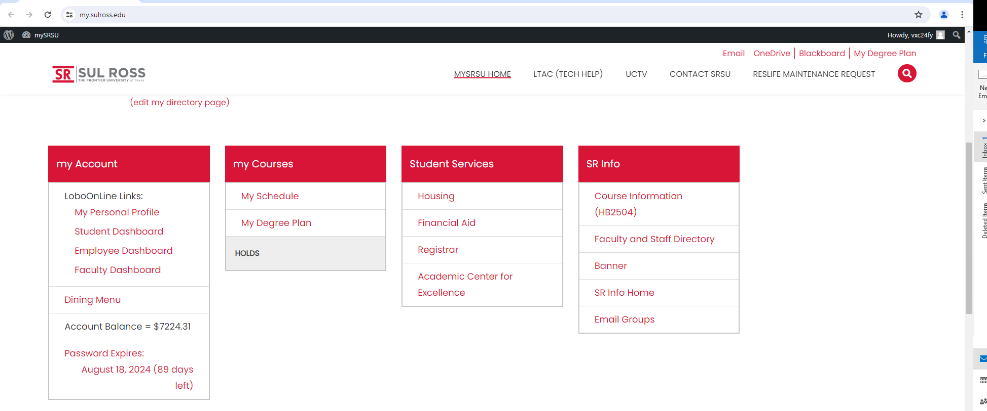
Click on “Student Dashboard”
New Lobo

Slide 4
New Lobo
Click on “Student Account Suite (Bill+Payment)”
New Lobo

Slide 5
Type in your credentials
“Username”& “Password”

Slide 6
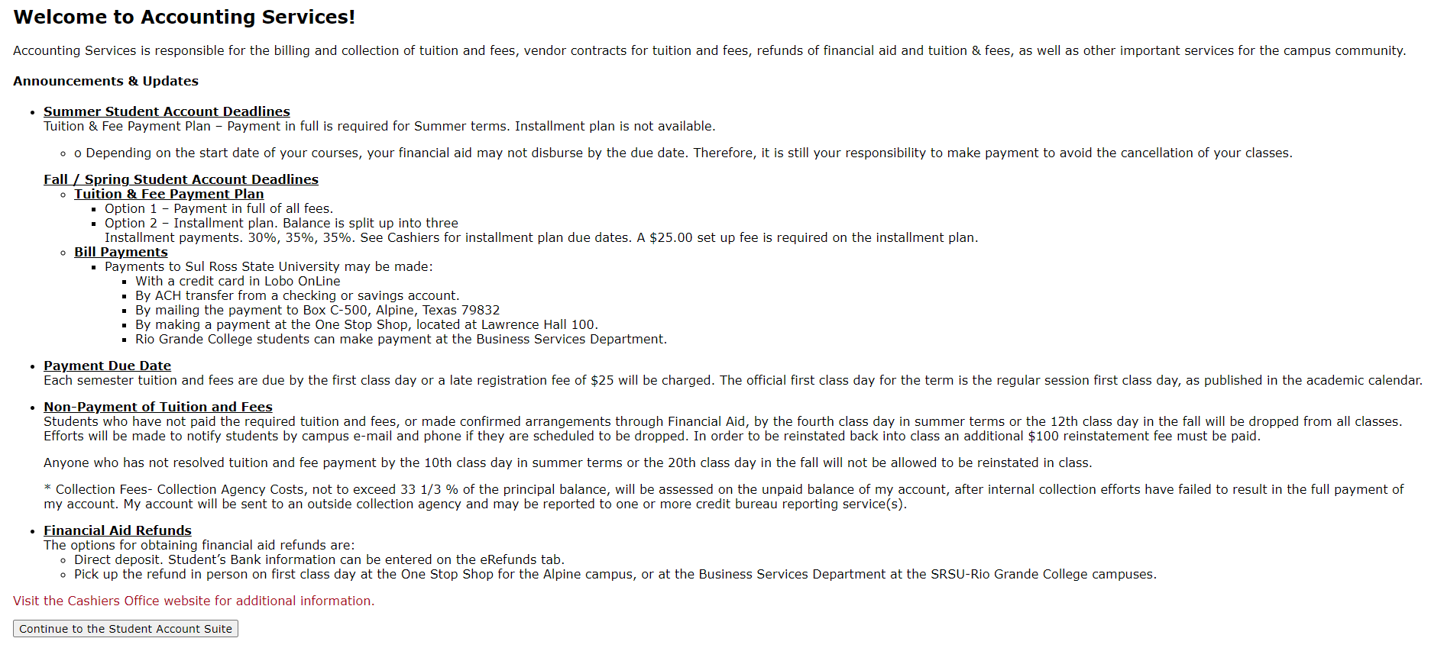
Click on button “Continue to the Student Account Suite”

Slide 7
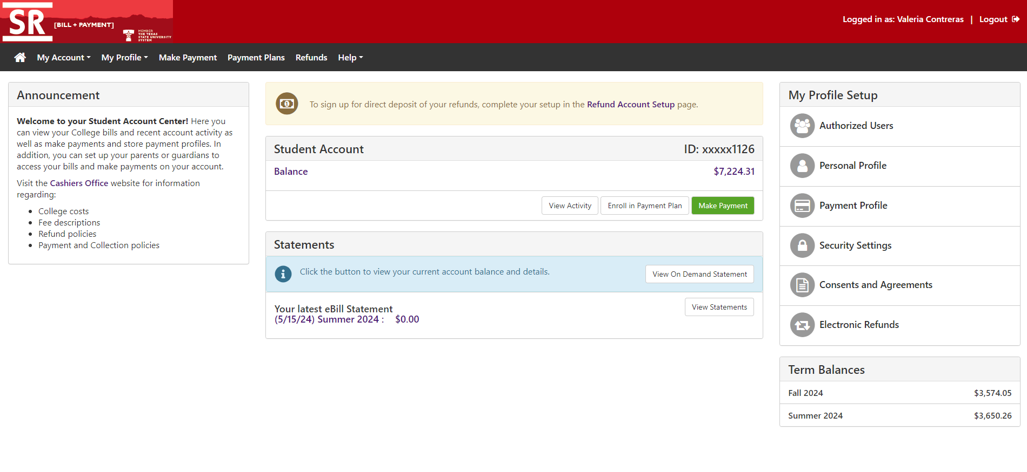
Click on “Refund Account Setup”

Slide 8
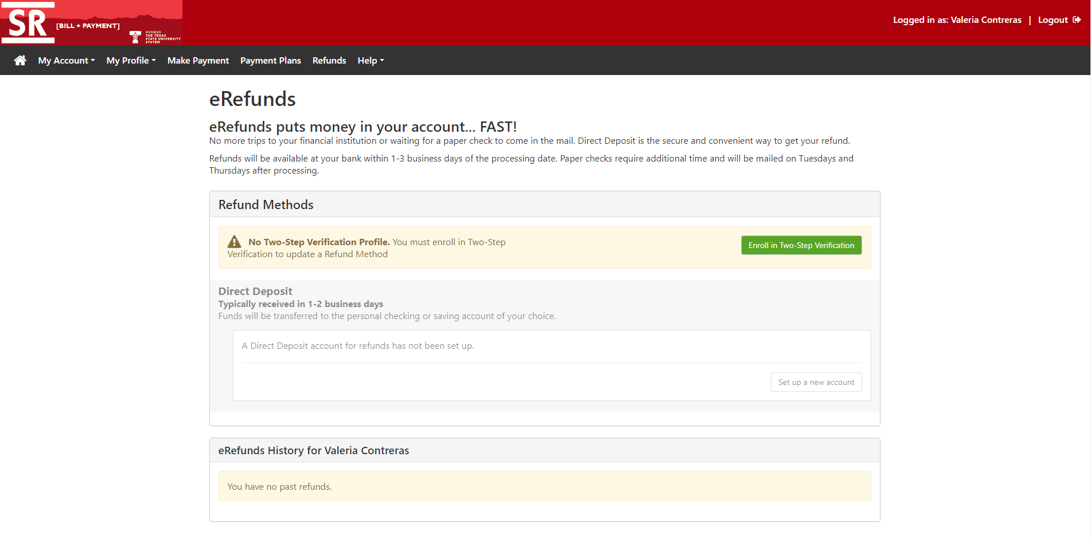
1. After Reviewing click “Enroll in Two-Step Verification.”

Slide 9
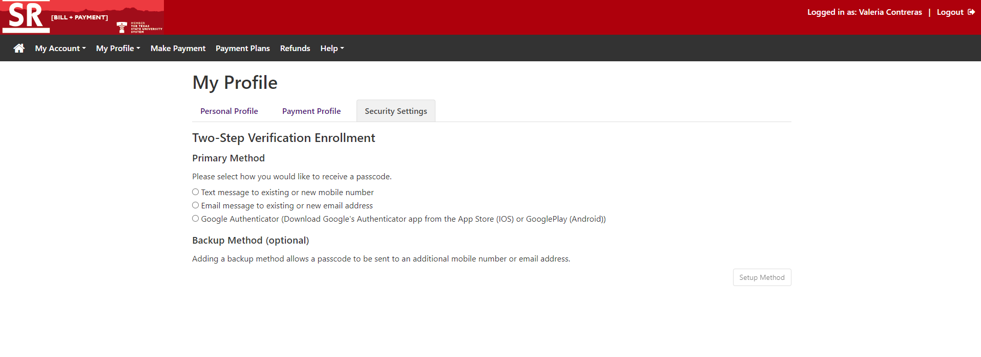
1. Chose your preferred payment

Slide 10
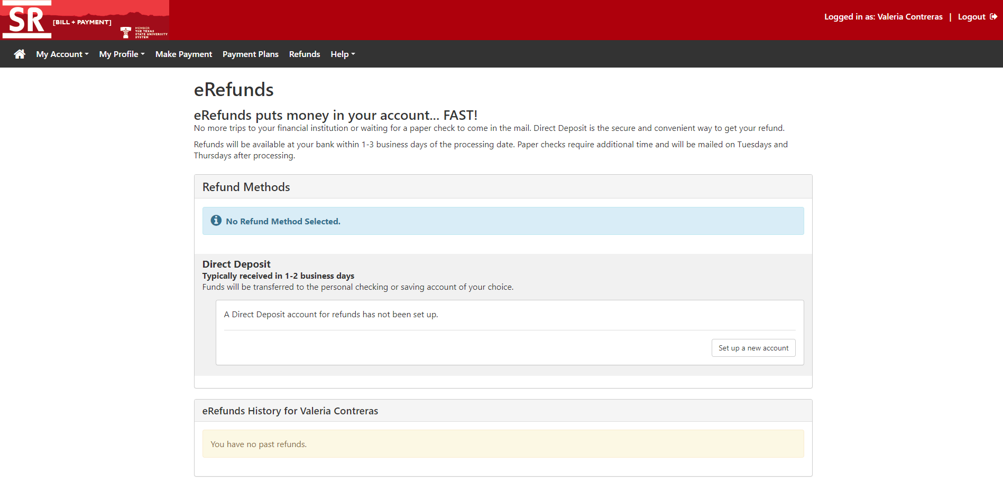
1. Click “Set up a new account”

Slide 11
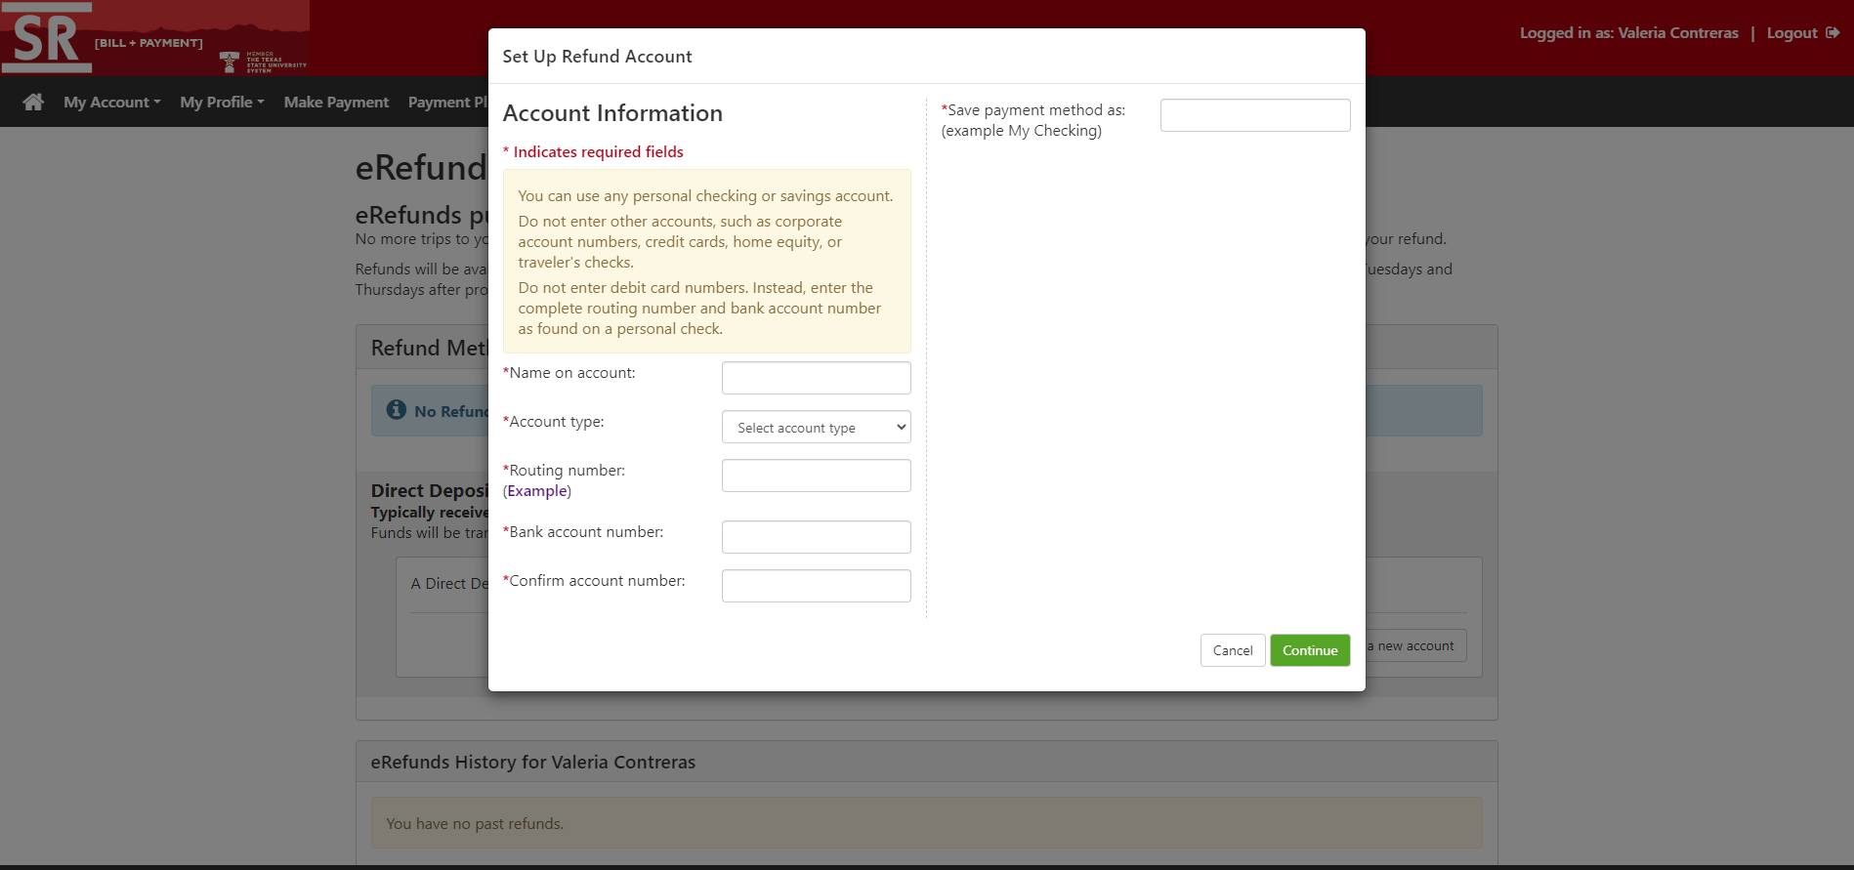
2. Enter “note”
1. Enter your Account Information
3. Review & Verify your Information

Slide 12
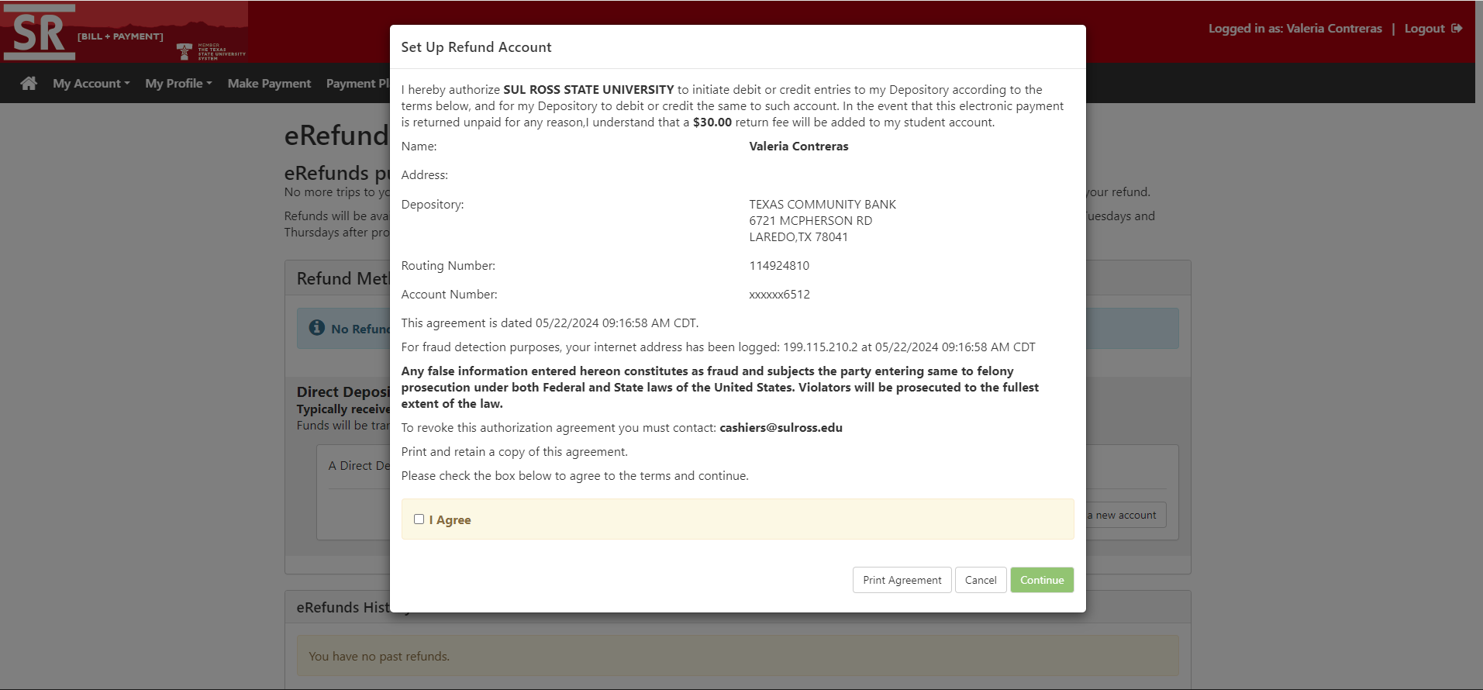
1. Verify your Account Information
3. Print Agreement
2. Checkbox
4. Click Continue

Slide 13
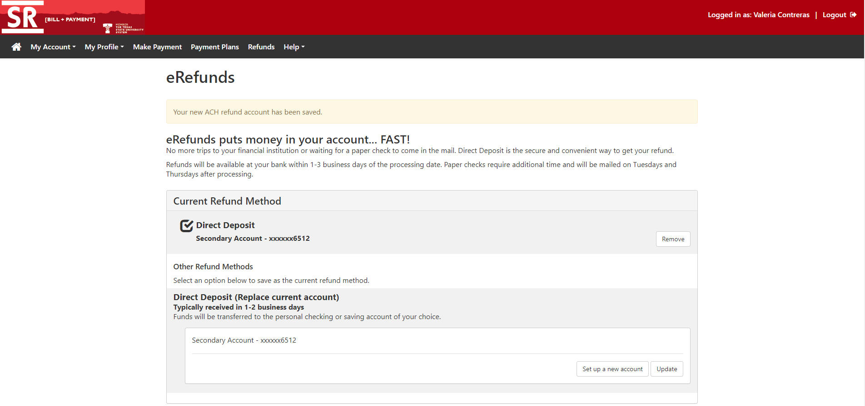
1. Verify Information
3. Set up a new account
4. Need to make any edits
2. Verify Information

Slide 14
Contact Information
Bursar’s office Cashier’s office
Mickey Corbett | Bursar Terrie salas | head cashier
432-837-8056 432-837-8253
mcorbett@sulross.edu Cashiers@SulRoss.edu
Valeria Contreras- ar coordinator
432-837-8007
Valeria.contreras@sulross.edu
collections-alp@sulross.edu

